Slide 1
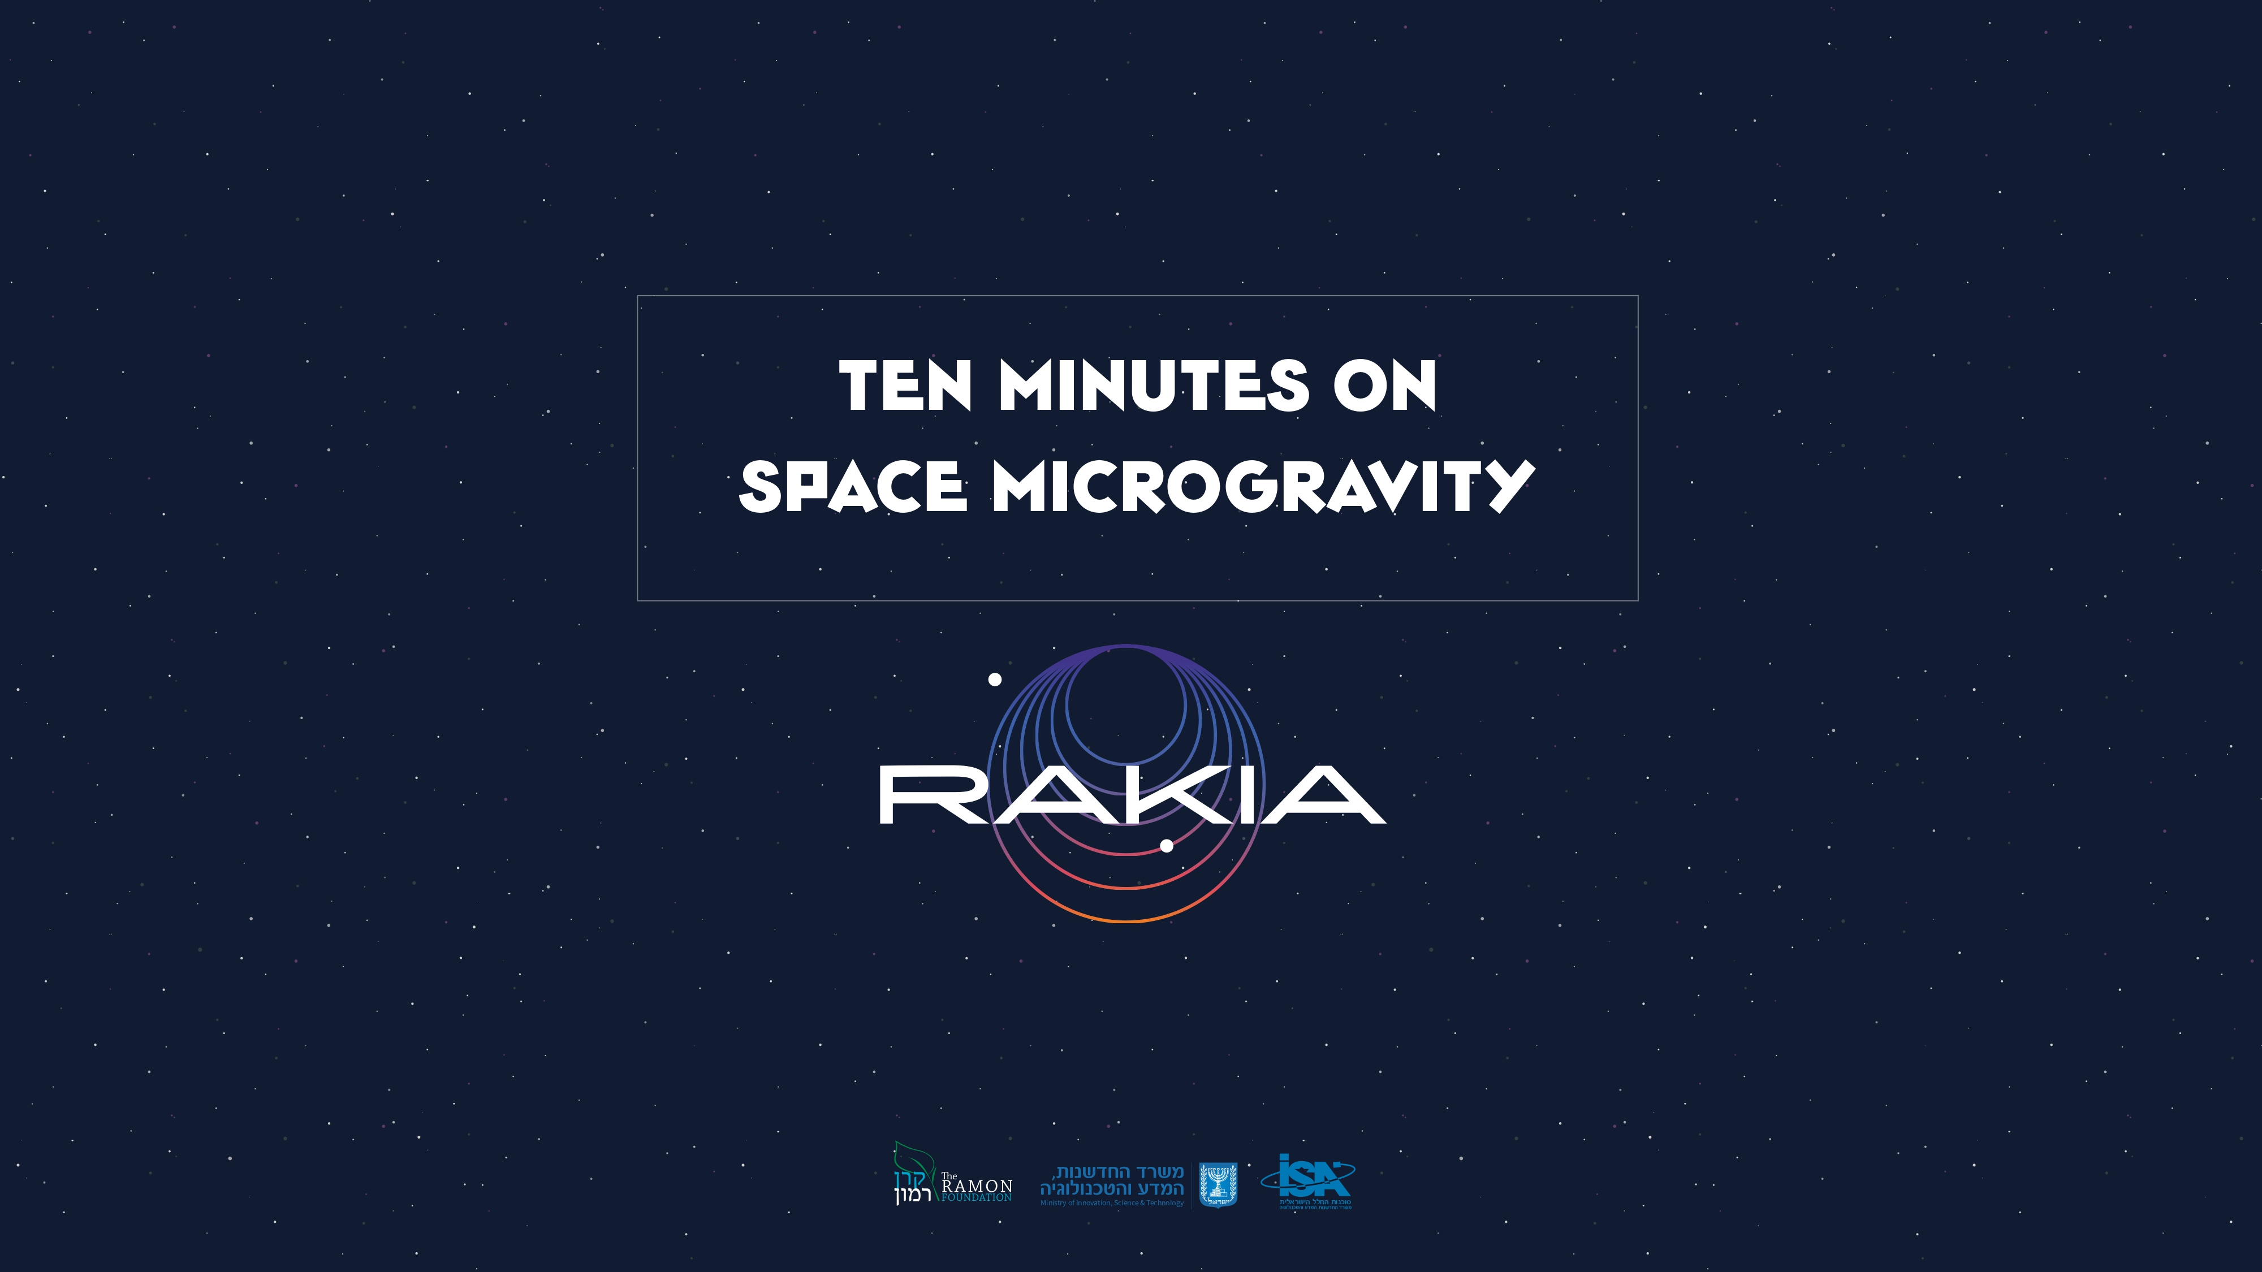

Slide 2
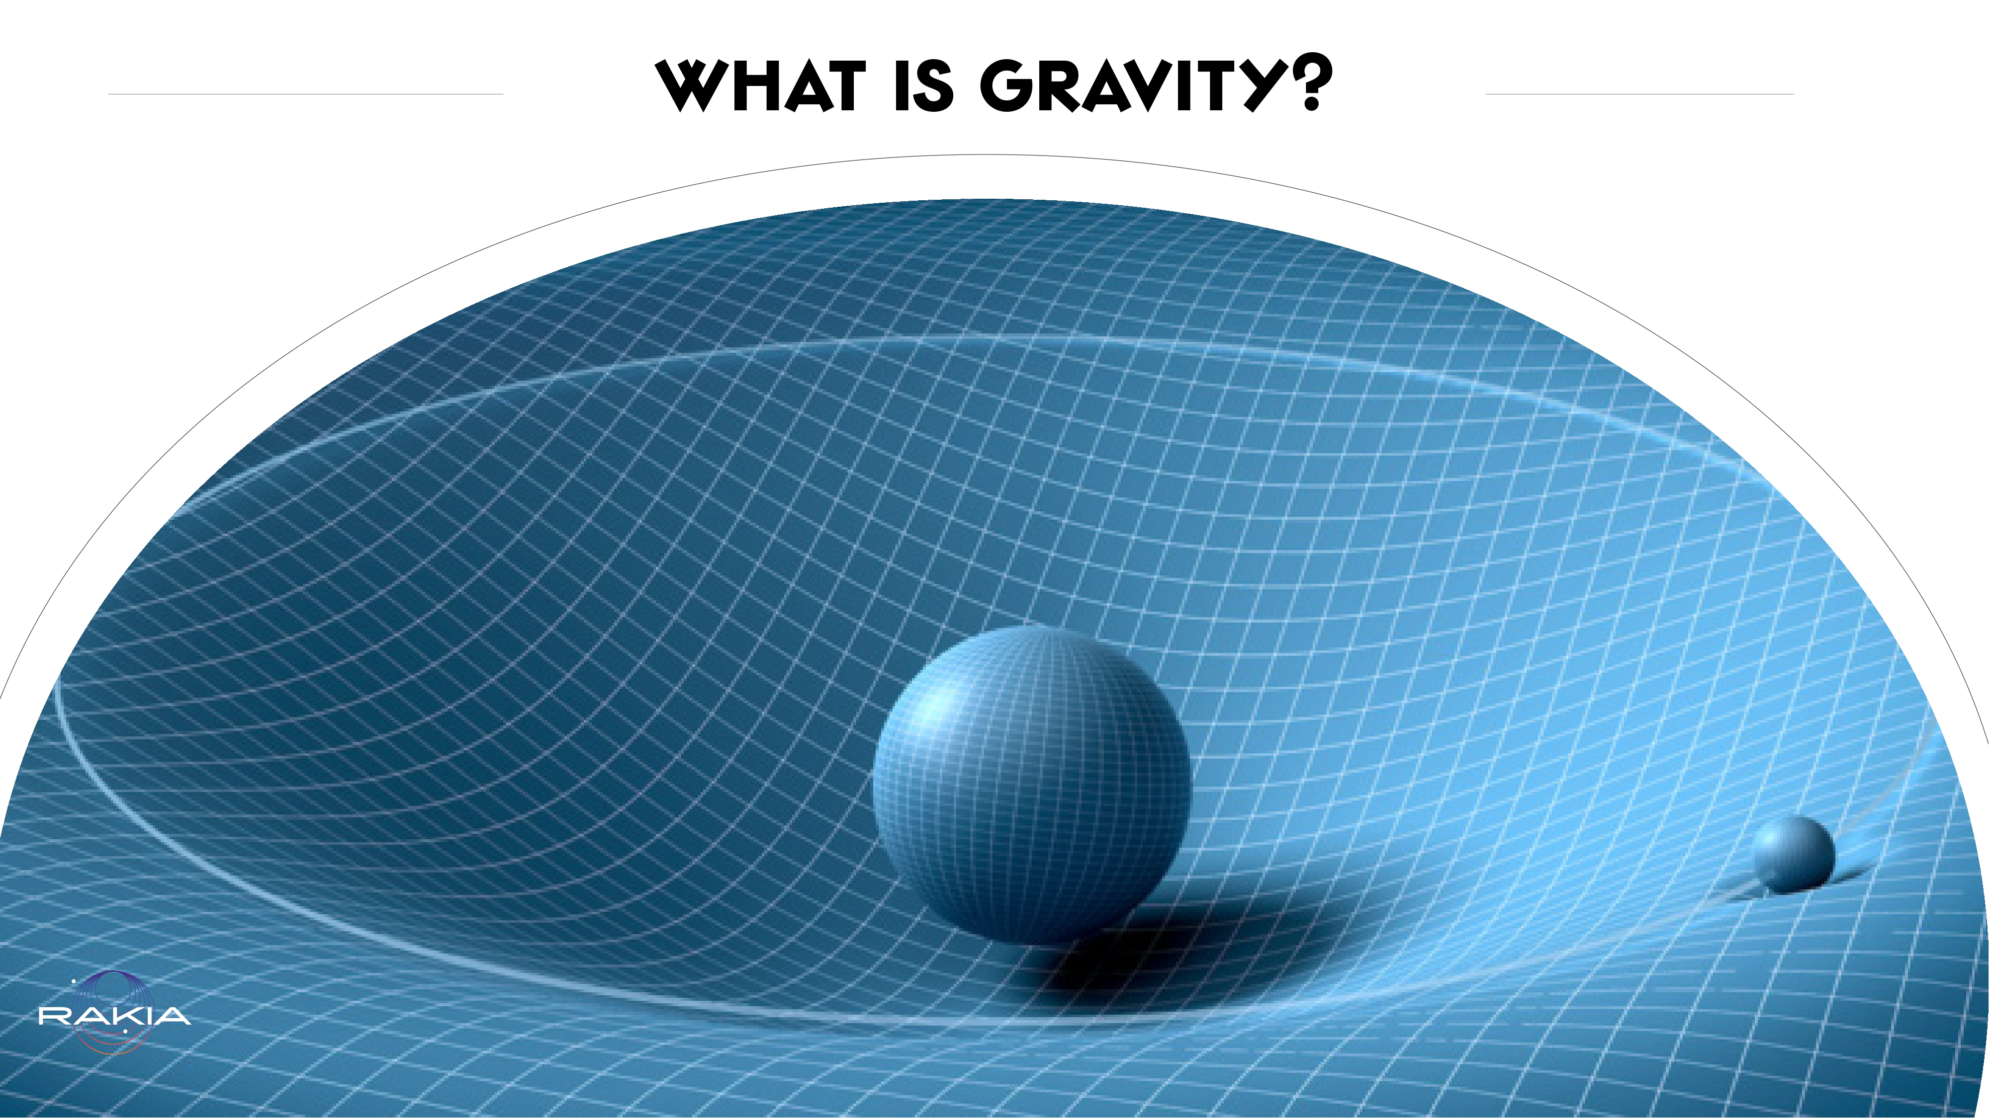
Notes:
Gravity is the force that attracts every two objects one to the other. The force is called the “gravitational force”. This force depends on the mass of each body - generally the more massive something is, meaning the more matter and density - the stronger its gravitational force. Gravity can be likened to a depression in a mattress. The more massive a body, the deeper the depression and anything approaching it will be attracted to it and fall towards it. The Earth, which is a huge planet with tremendous mass compared with us, attracts everything around it towards it. This is why we fall back when we jump, instead of just drifting on and on endlessly toward the clouds. Even we exert a tiny amount of gravitational force on everything around us. However since we are so small, relatively speaking, our gravitational force is virtually unnoticeable.

Slide 3
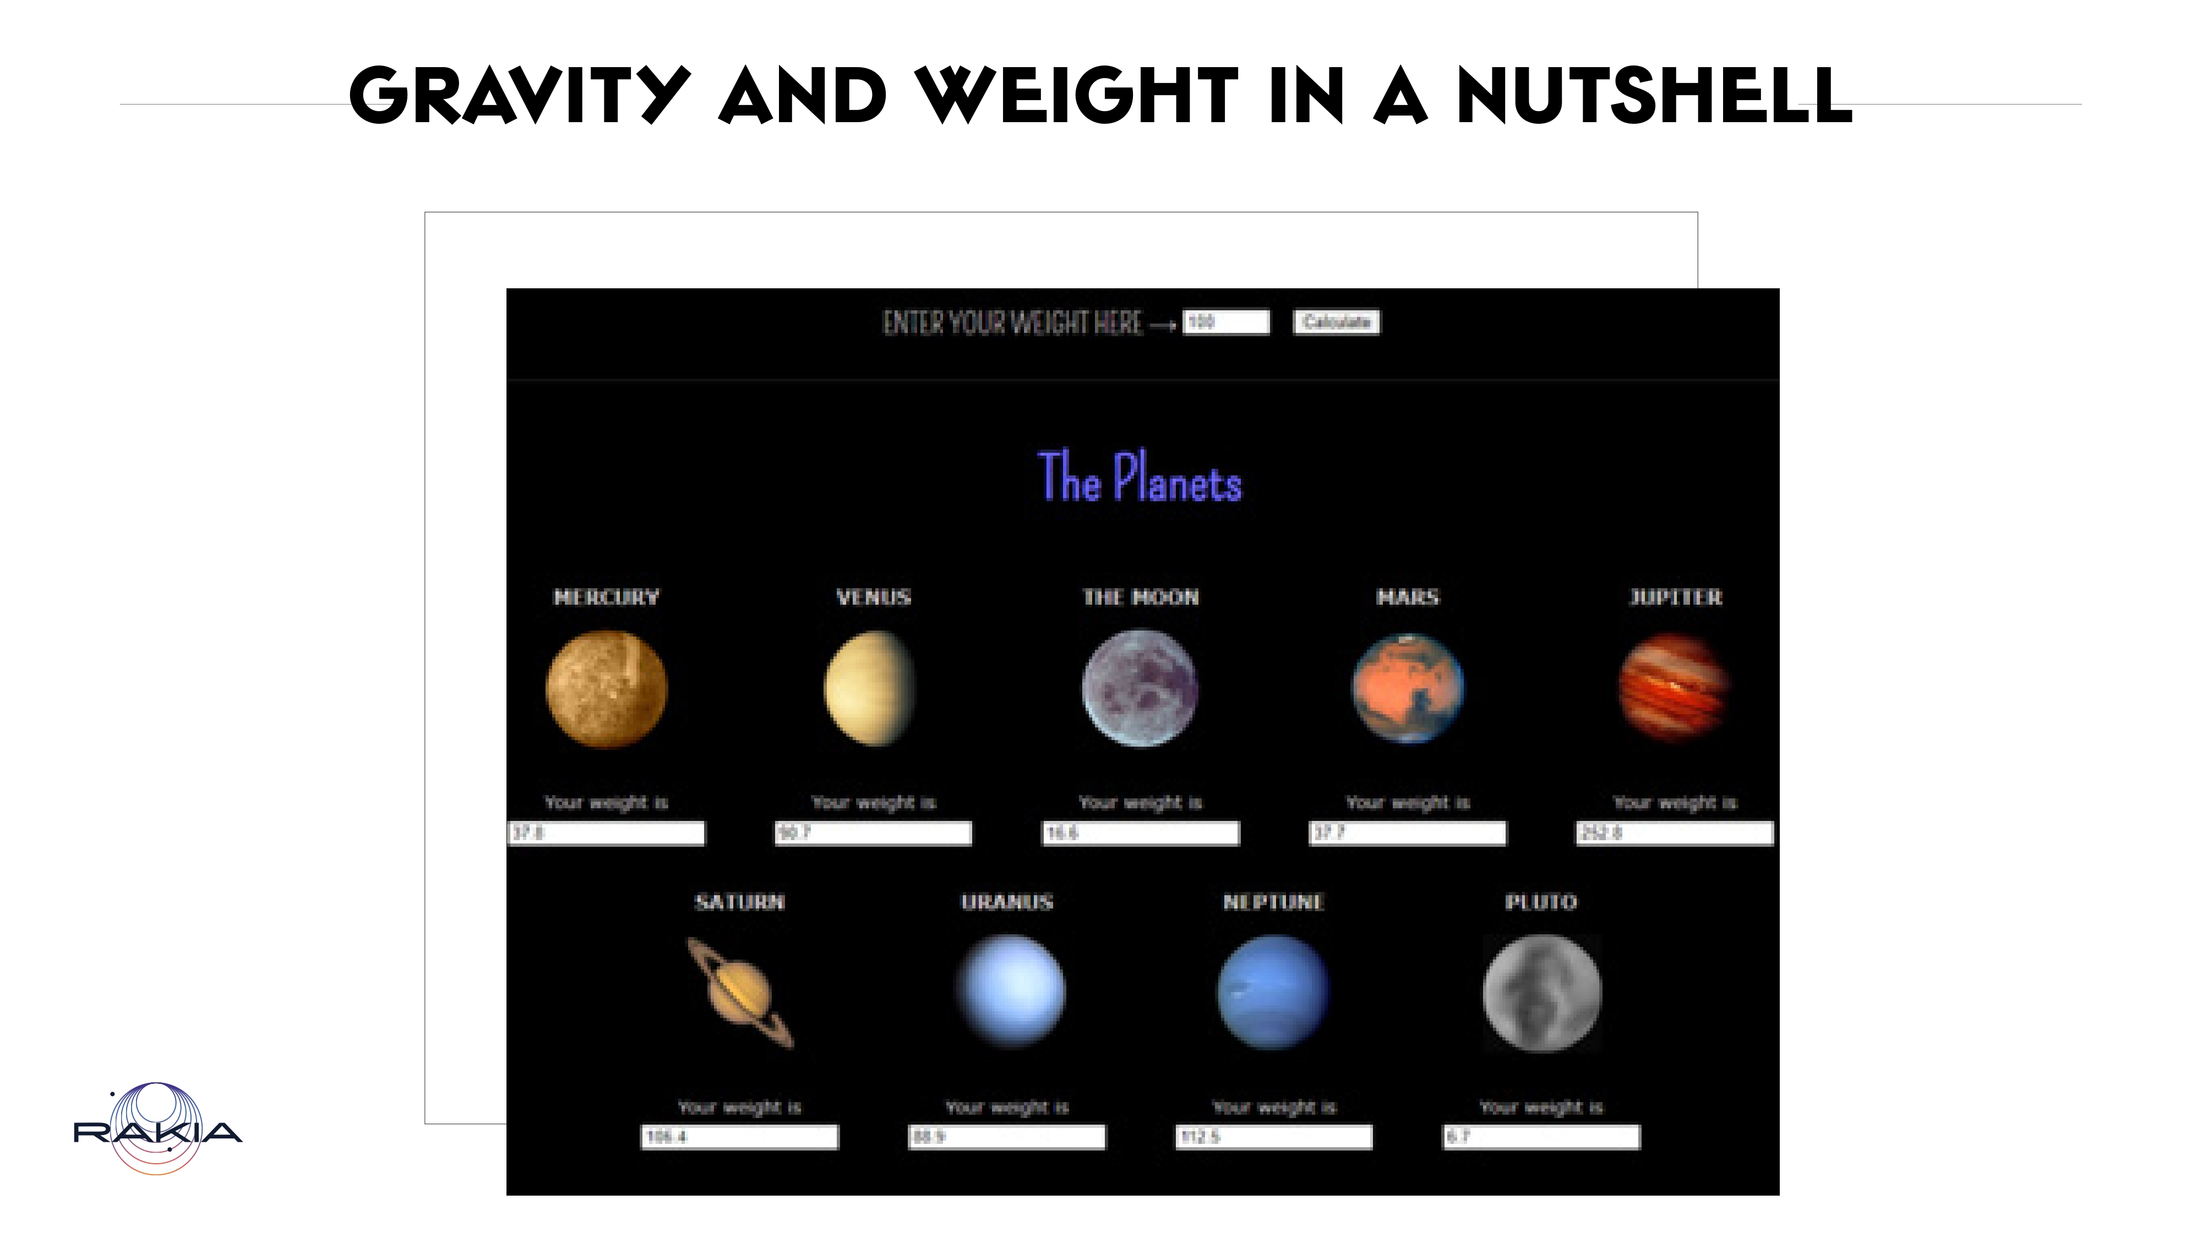
Notes:
The weight we see when we weigh ourselves is in fact an expression of the mutual force being applied between our bodies and Earth’s gravity. Therefore our weight will be different on the moon (a person weighing 100 kilograms on Earth will weigh about 16 kilograms on the moon) or on Mars (a person weighing 100 kilograms on Earth will weigh about 37 kilograms on Mars)! And if you were able to stand on the surface of our enormous Sun, then a person weighing 100 kilograms on Earth would weigh 2707 kilograms on the Sun!
To check how much you would weigh on various heavenly bodies:https://www.exploratorium.edu/ronh/weight

Slide 4
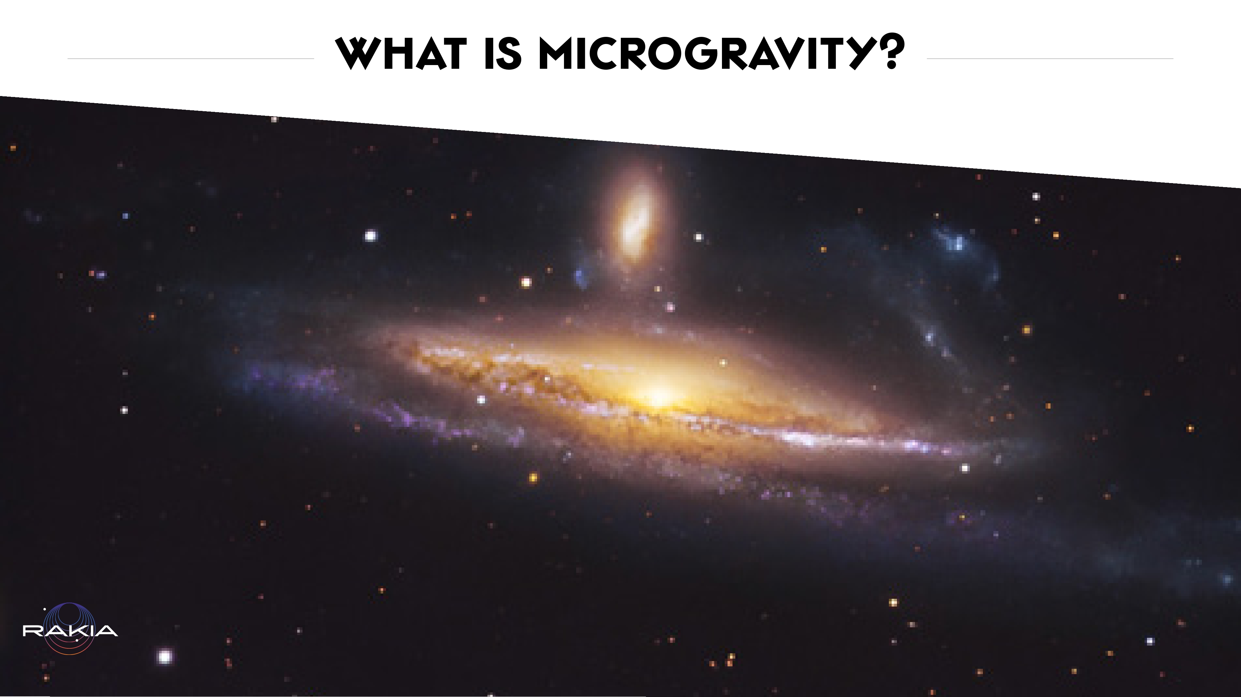
Notes:
Micro means tiny. Microgravity is a state in which the gravitational force is virtually unnoticeable.
Please note!! This is not weightlessness or actual lack of gravity! In space, since there are so many large heavenly bodies, we would have to travel far away to the empty intergalactic void in order to really be in a place where we would be exposed to almost zero gravitational force

Slide 5
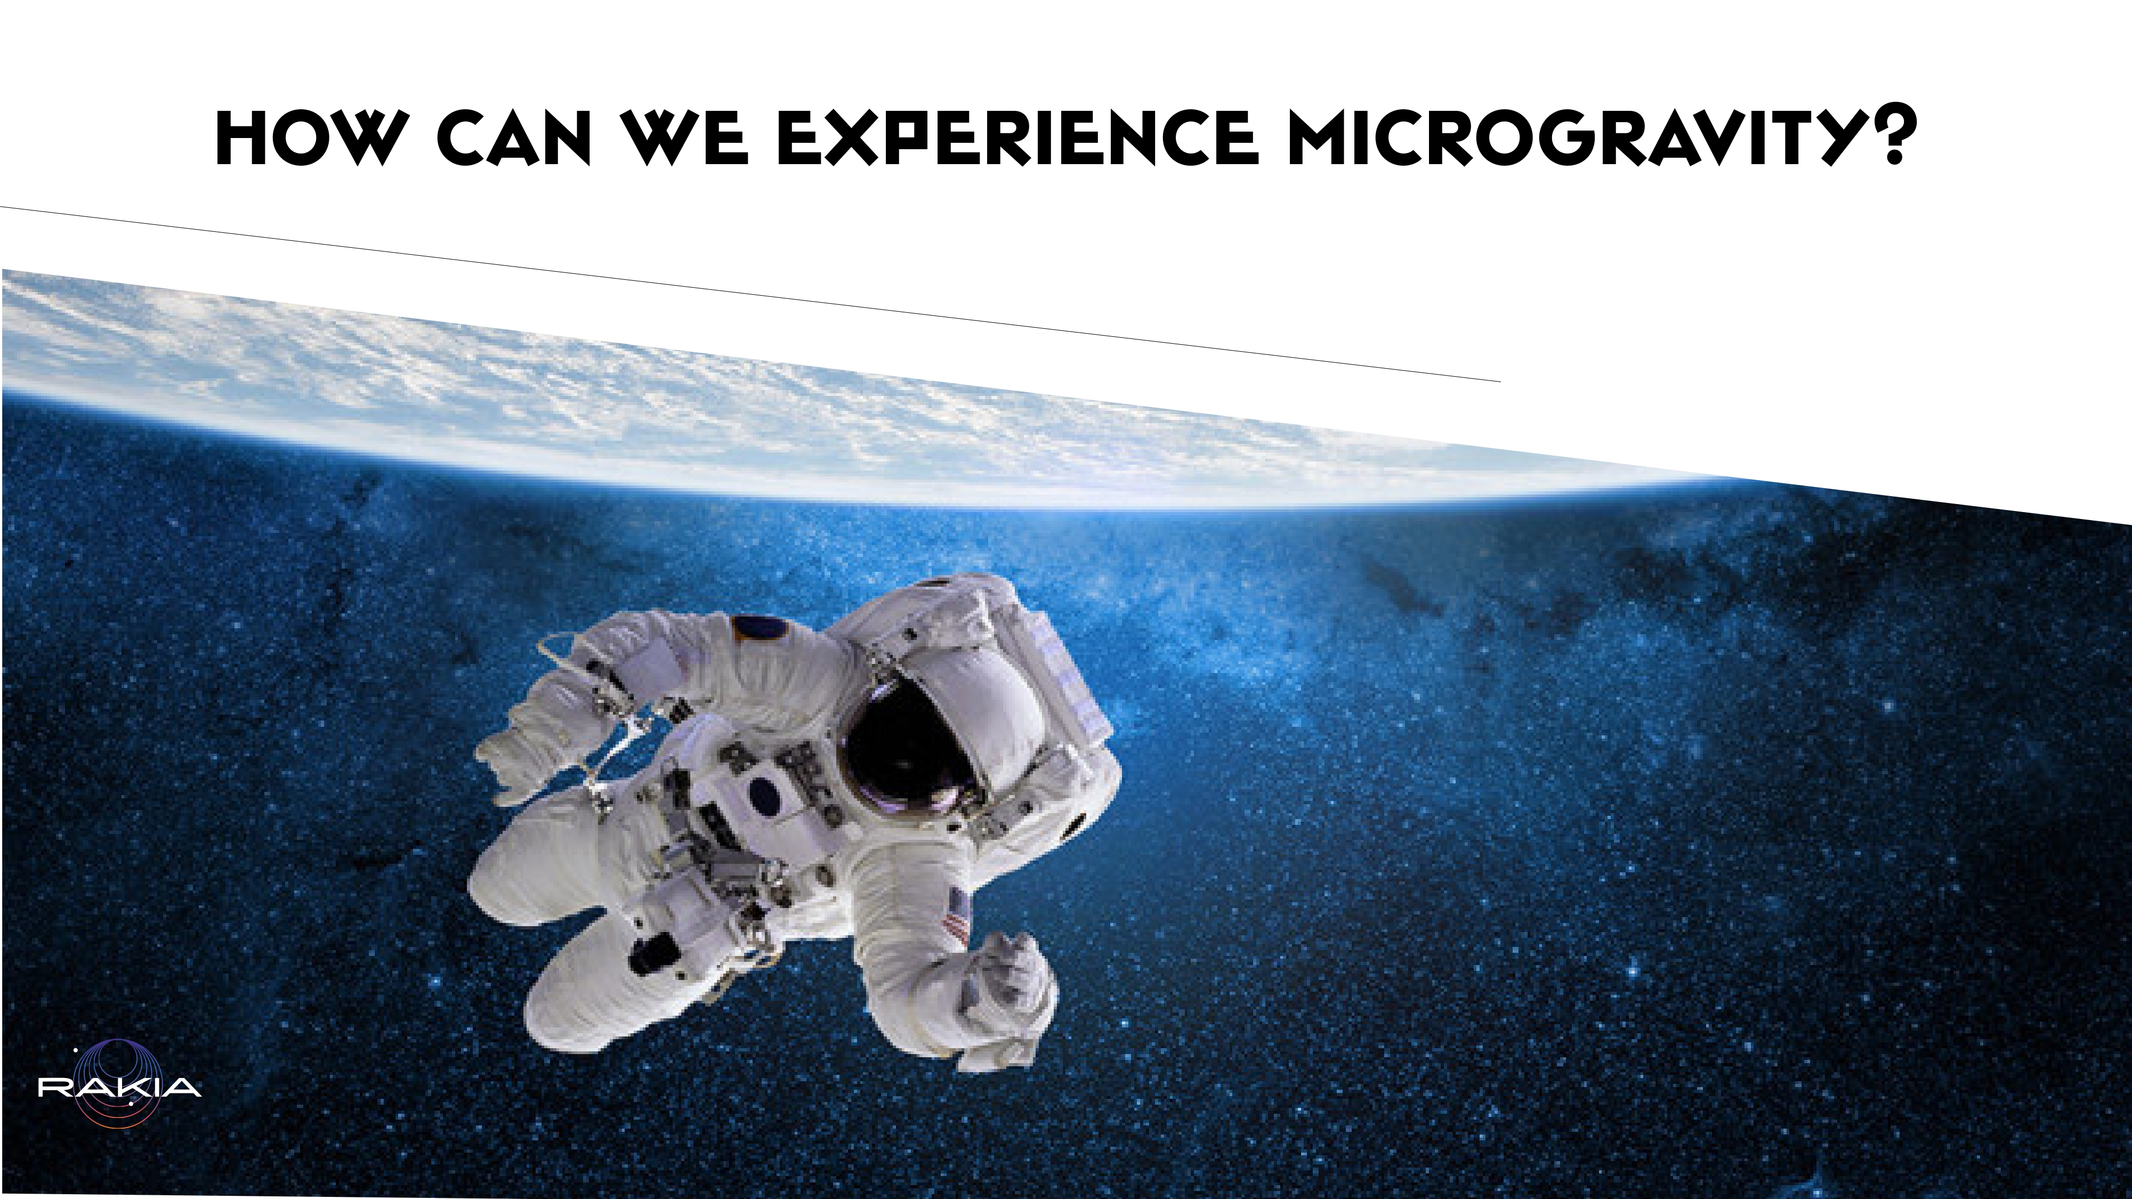
Notes:
We experience microgravity for brief instances right here on Earth! These are the moments when other forces acting on a body counteract the Earth’s gravity. In those moments - the body experiences a feeling of weightlessness.
Imagine you are in an elevator at the top of a skyscraper. Do you know that feeling when it begins going down, and the stomach feels as if it’s going to jump out of our throats?
Well if at that moment you’d be standing on a scale, the dial would show your weight decreasing as you go down with the elevator. The same happens when an airplane dives. Or when parachuting! Or when tossing a ball upwards, at that brief moment when it hangs in mid-air before beginning its fall back to the ground. These are moments, right here on Earth, where microgravity exists for an instant.

Slide 6
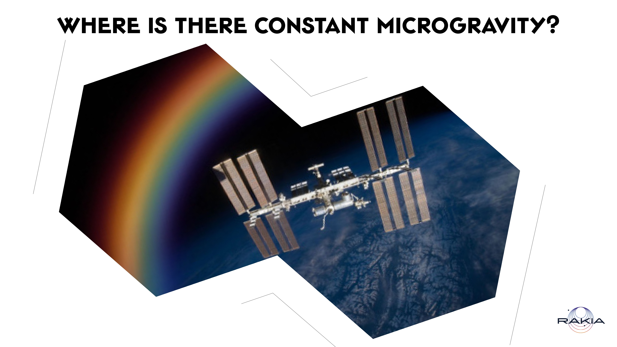
Notes:
n the International Space Station! This is an immense flying laboratory, as large as two soccer fields, orbiting the Earth at an altitude of 400 km above ground surface and at a speed of approximately 7 km per second! The Station is in what is known as “freefall”. It is constantly falling toward Earth but it continually keeps “missing” it, such that it continues to orbit us.
The Station is used to study life in space and microgravity, and to conduct research for developments which will benefit humanity as a whole, on Earth and beyond. Many products now in everyday use in ordinary households are the outcome of research and development done on the International Space Station

Slide 7
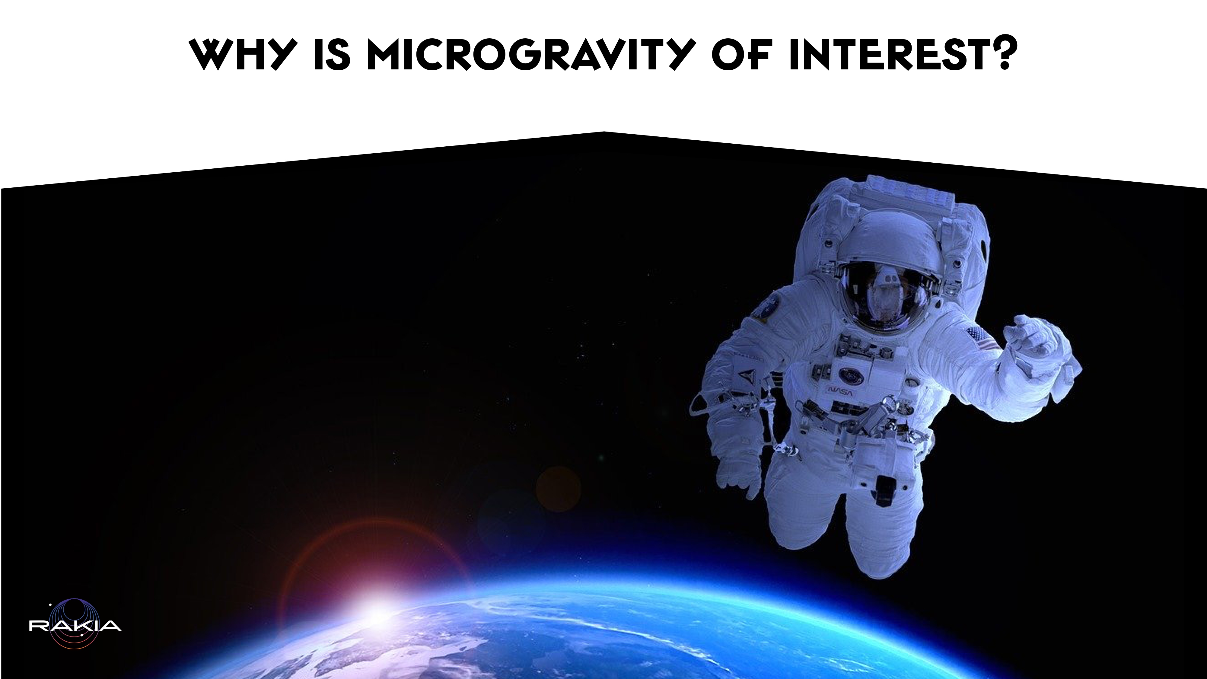
Notes:
All the materials and processes we are familiar with here on Earth are created and exist under conditions of normal gravity. Before we developed the ability to rise into an orbit around Earth we were only able to observe how processes take place and behave under microgravity for a few brief moments using special instruments. Under conditions of microgravity, differences were discovered in a wide variety of phenomena, and also completely new phenomena were discovered. Thanks to the research taking place under microgravity in the Space Station and on other satellites and spacecraft (such as the space shuttles!) we are able to expand and fine-tune our scientific knowledge, and also to develop processes and materials which may contribute toward life on Earth, and also to prepare for prolonged human existence beyond our planet.

Slide 8
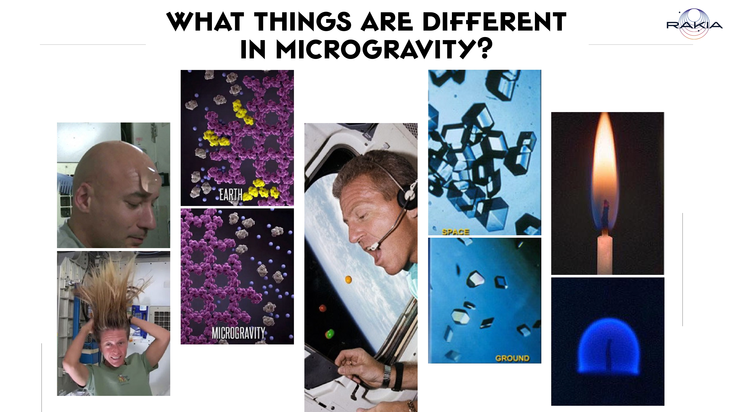
Notes:
Astronauts can move hundreds of kilograms of weight with just one finger In the Space Station there is no granular salt and pepper, these exist only in a solution because the grains would disperse in all directions and might even endanger the instruments Things we are familiar with behave differently. For example, a flame burns round, rather than upwards, proteins form error-free, perfect crystals can be grown, fluids of different densities do not separate into layers, particles do not sink in a solution... And so on and so forth. One of the most striking examples is the way fluids behave under microgravity compared with the way they behave on Earth

Slide 9
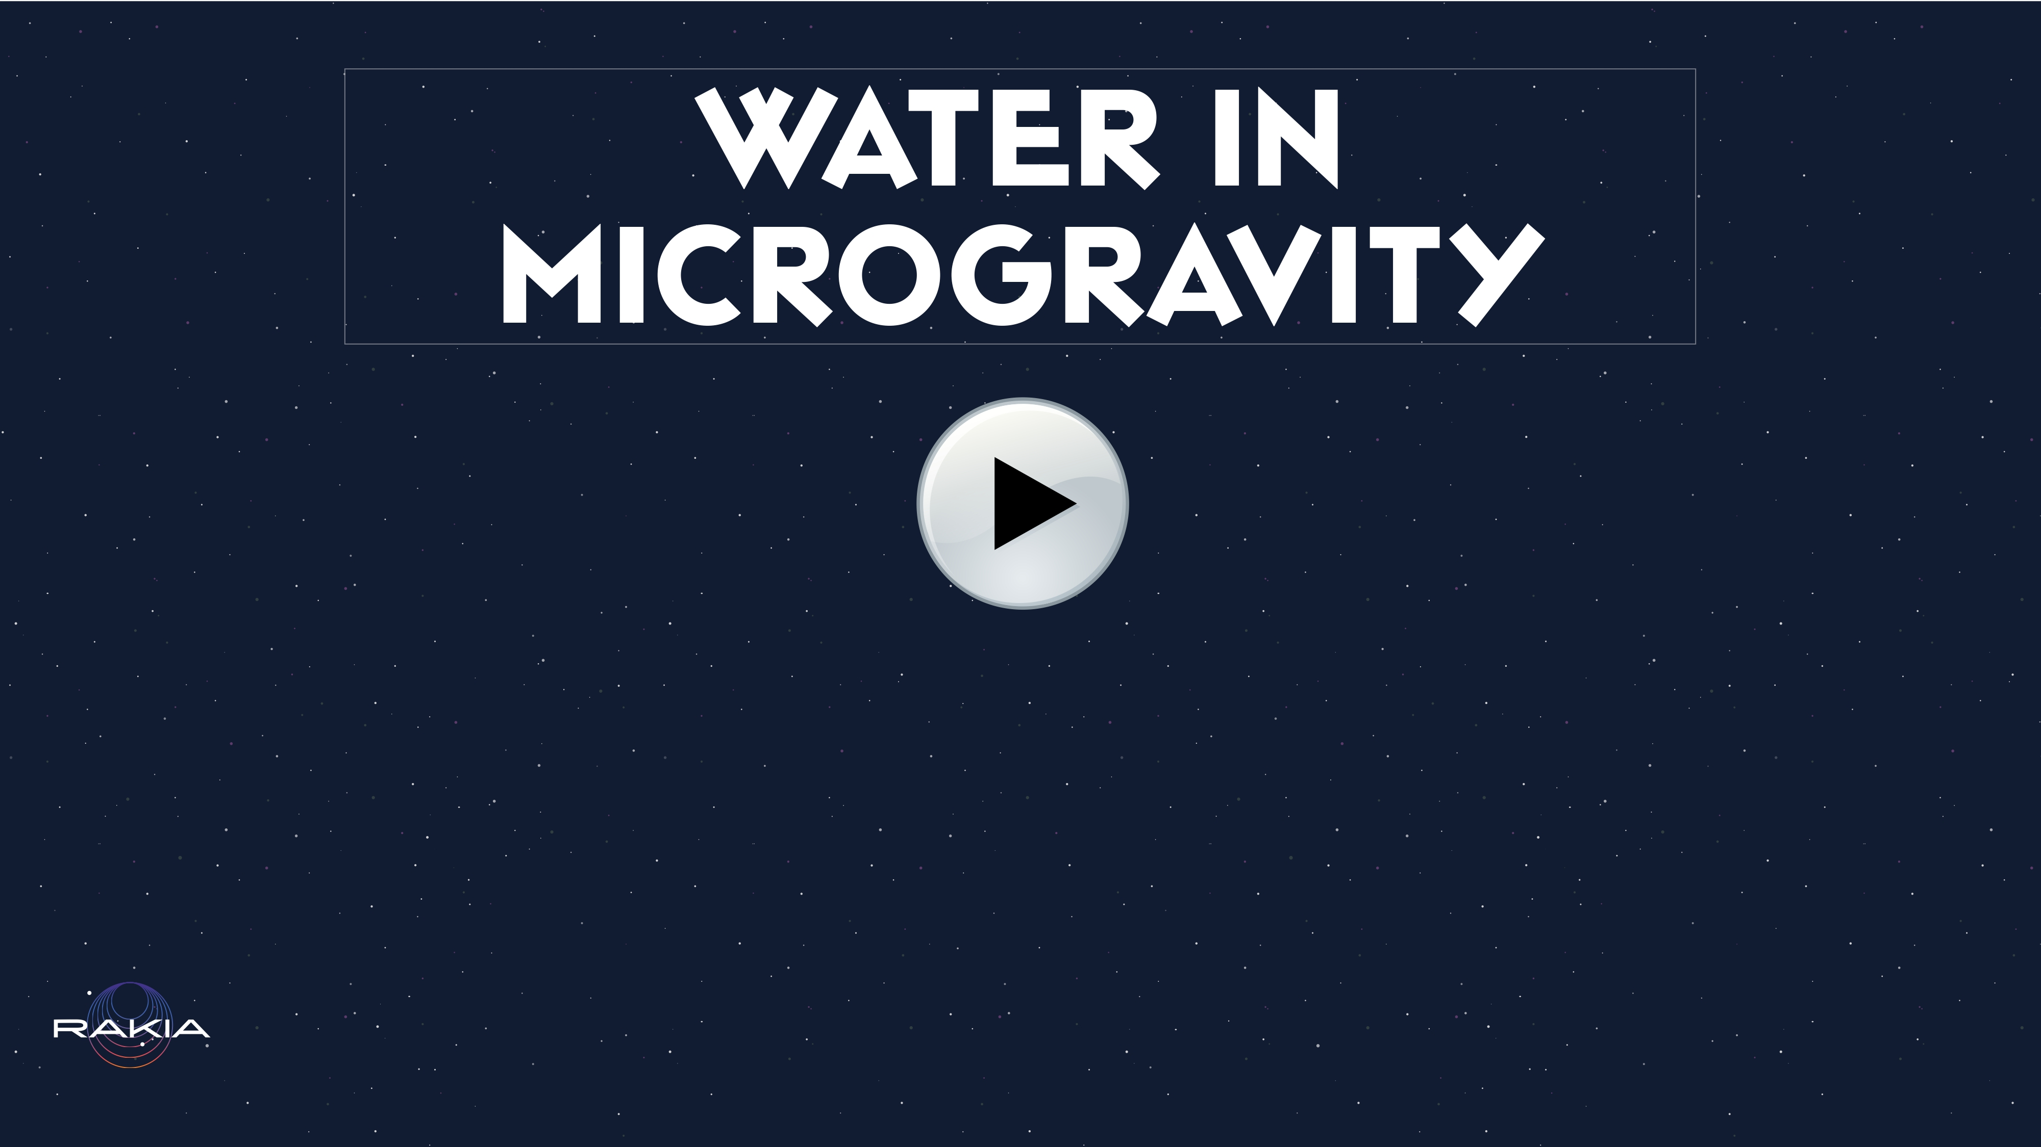
Notes:
On Earth, the gravitational force is stronger than other forces Acting on the water molecules, and therefore we are used to seeing water flowing downwards on any surface. With microgravity, other forces, which are weak in comparison to gravity (such as cohesion, adhesion and surface tension) are strong enough in the absence of gravity to determine how drops of water will behave. Therefore, under conditions of microgravity, the water drops behave almost like soap bubbles here on Earth! They hover with the airflow or as a result of being pushed by an object, and in particular they adhere to one another, and to any surface. Adhesion - the molecular force of attraction in the area of contact between water and another surface Cohesion - the molecular force between one water molecule and another Surface tension - division of the force applied to a substance from inside and from outside as equally as possible This makes it particularly difficult for the astronauts to use the bathrooms or wash their hair, and the most fun can be had while drinking! And imagine, for example, what happens when one cries?
Moving Water in Space - 8K Ultra HD - YouTube

Slide 10
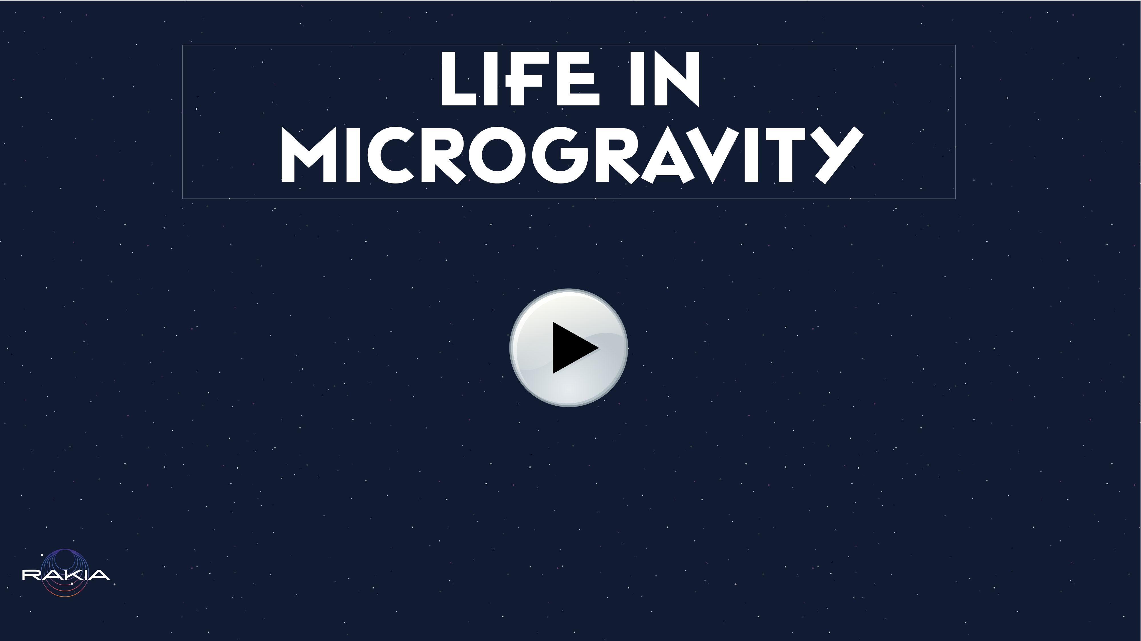
Notes:
One of the problems astronauts have to deal with in space is how to maintain their health. Due to microgravity, bone density and muscle mass decreases in their bodies, they experience vision problems due to the accumulation of fluids in the head, and despite two whole hours of exercise every day, the length of time people are able to remain in space without suffering irreversible damage to their health is still limited (estimated at two years)
https://www.youtube.com/watch?v=-TU1OkVctaI&ab_channel=NASAJohnson

Slide 11
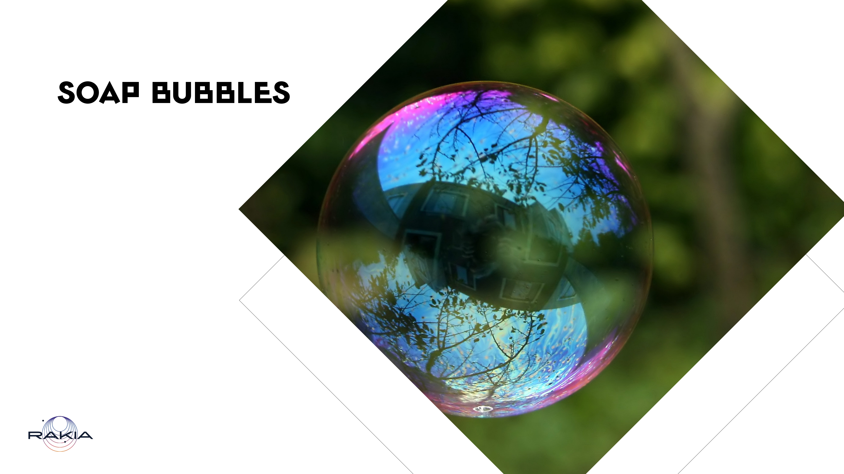
Notes:
In order to create particularly impressive, durable soap bubbles, we recommend the following recipe: 1:1:4 (1 dish soap: 1 sugar: 4 water) Dissolve one spoon of sugar in four spoons of hot water, mix until fully dissolved! Add a spoonful of dish soap and mix well You can make a simple bubble-making device by tying a loop of thick string to two sticks

Slide 12
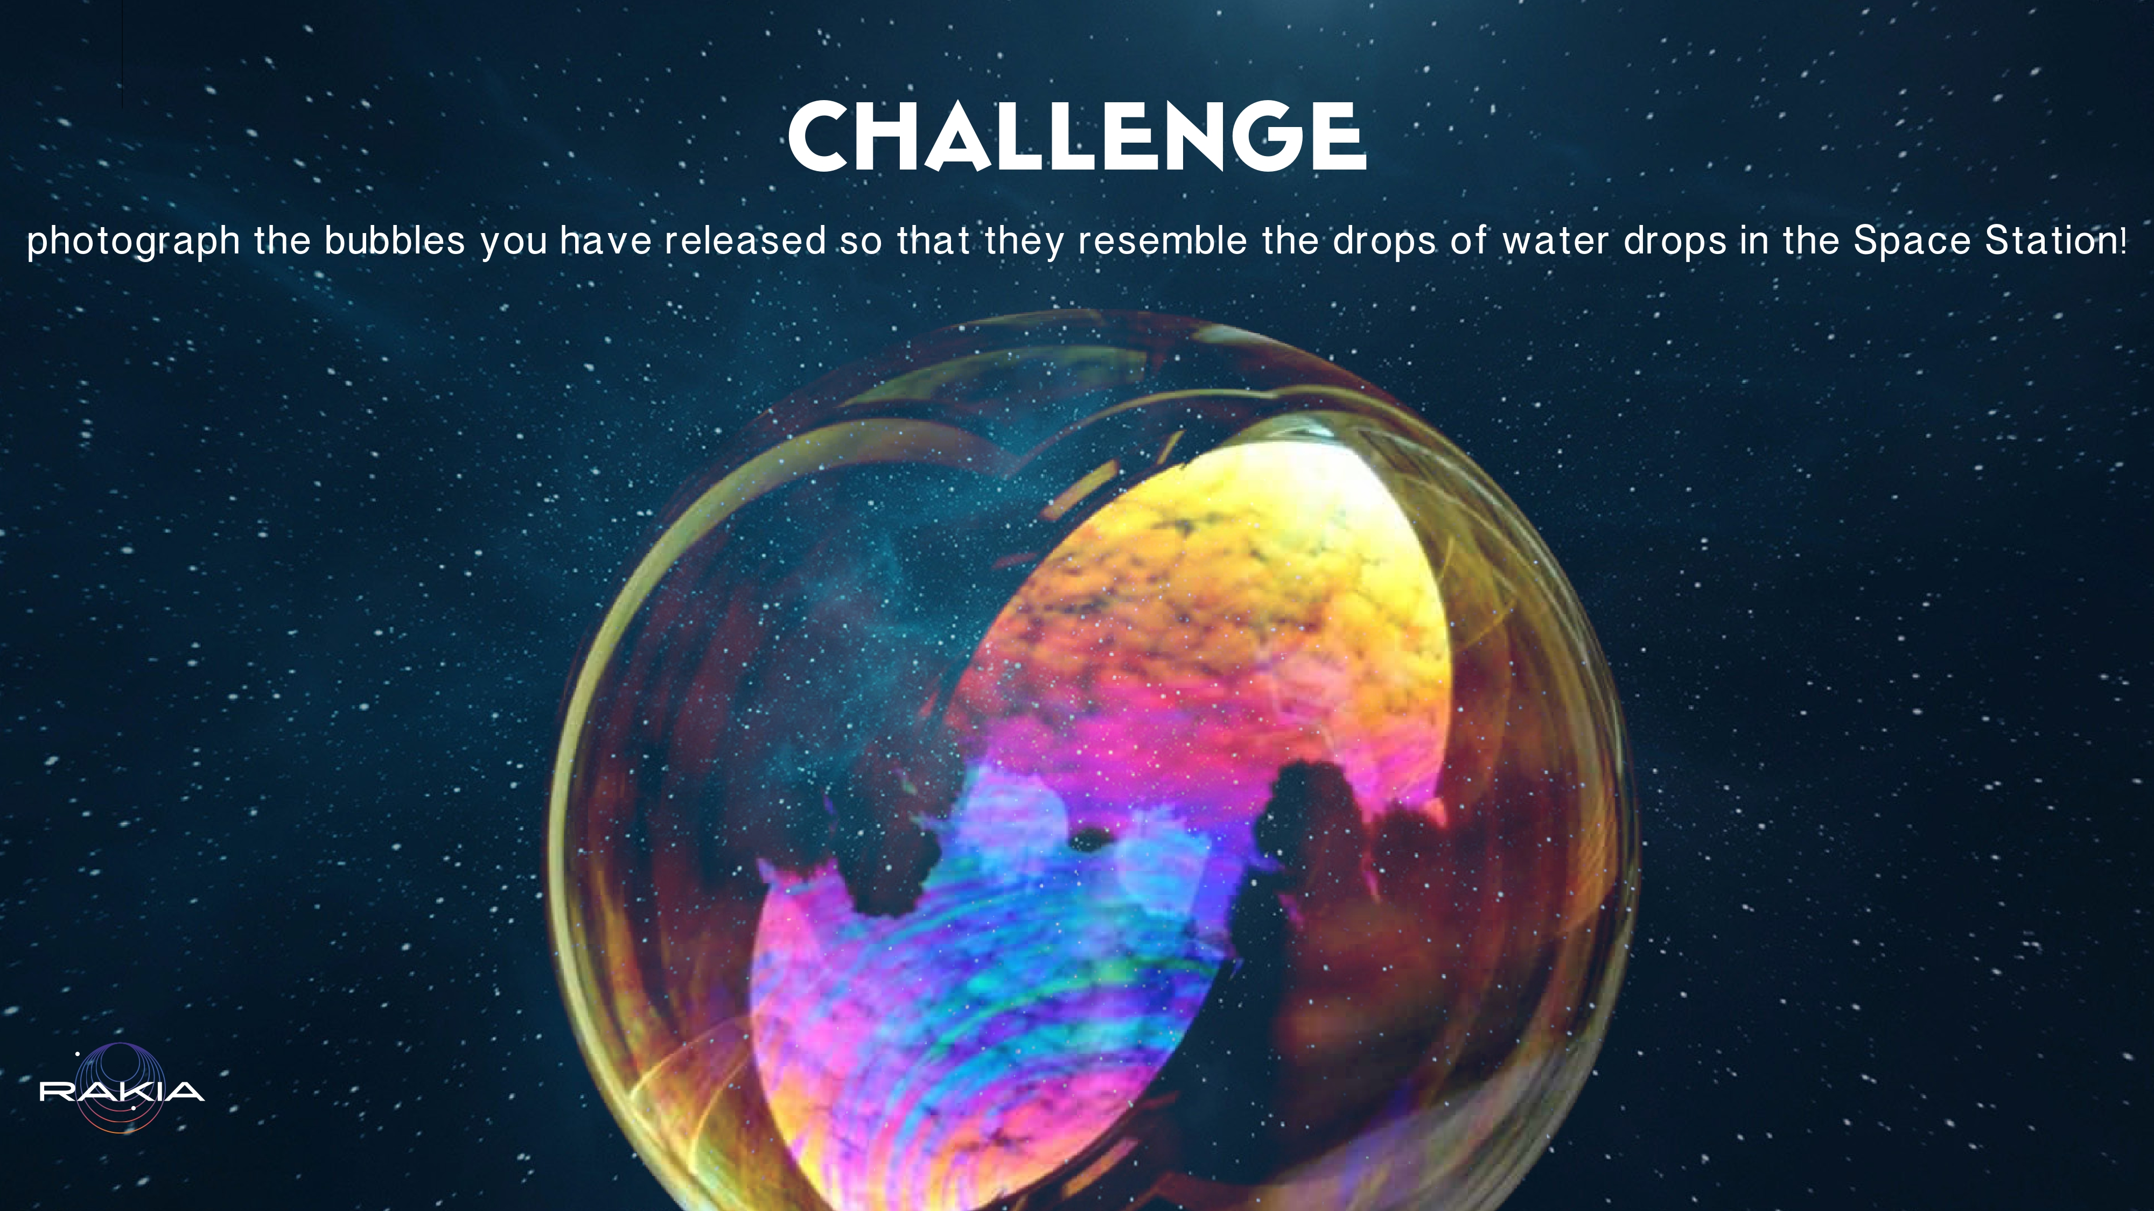
Notes:
photograph the bubbles you have released so that they resemble the drops of water drops in the Space Station

