Slide 1
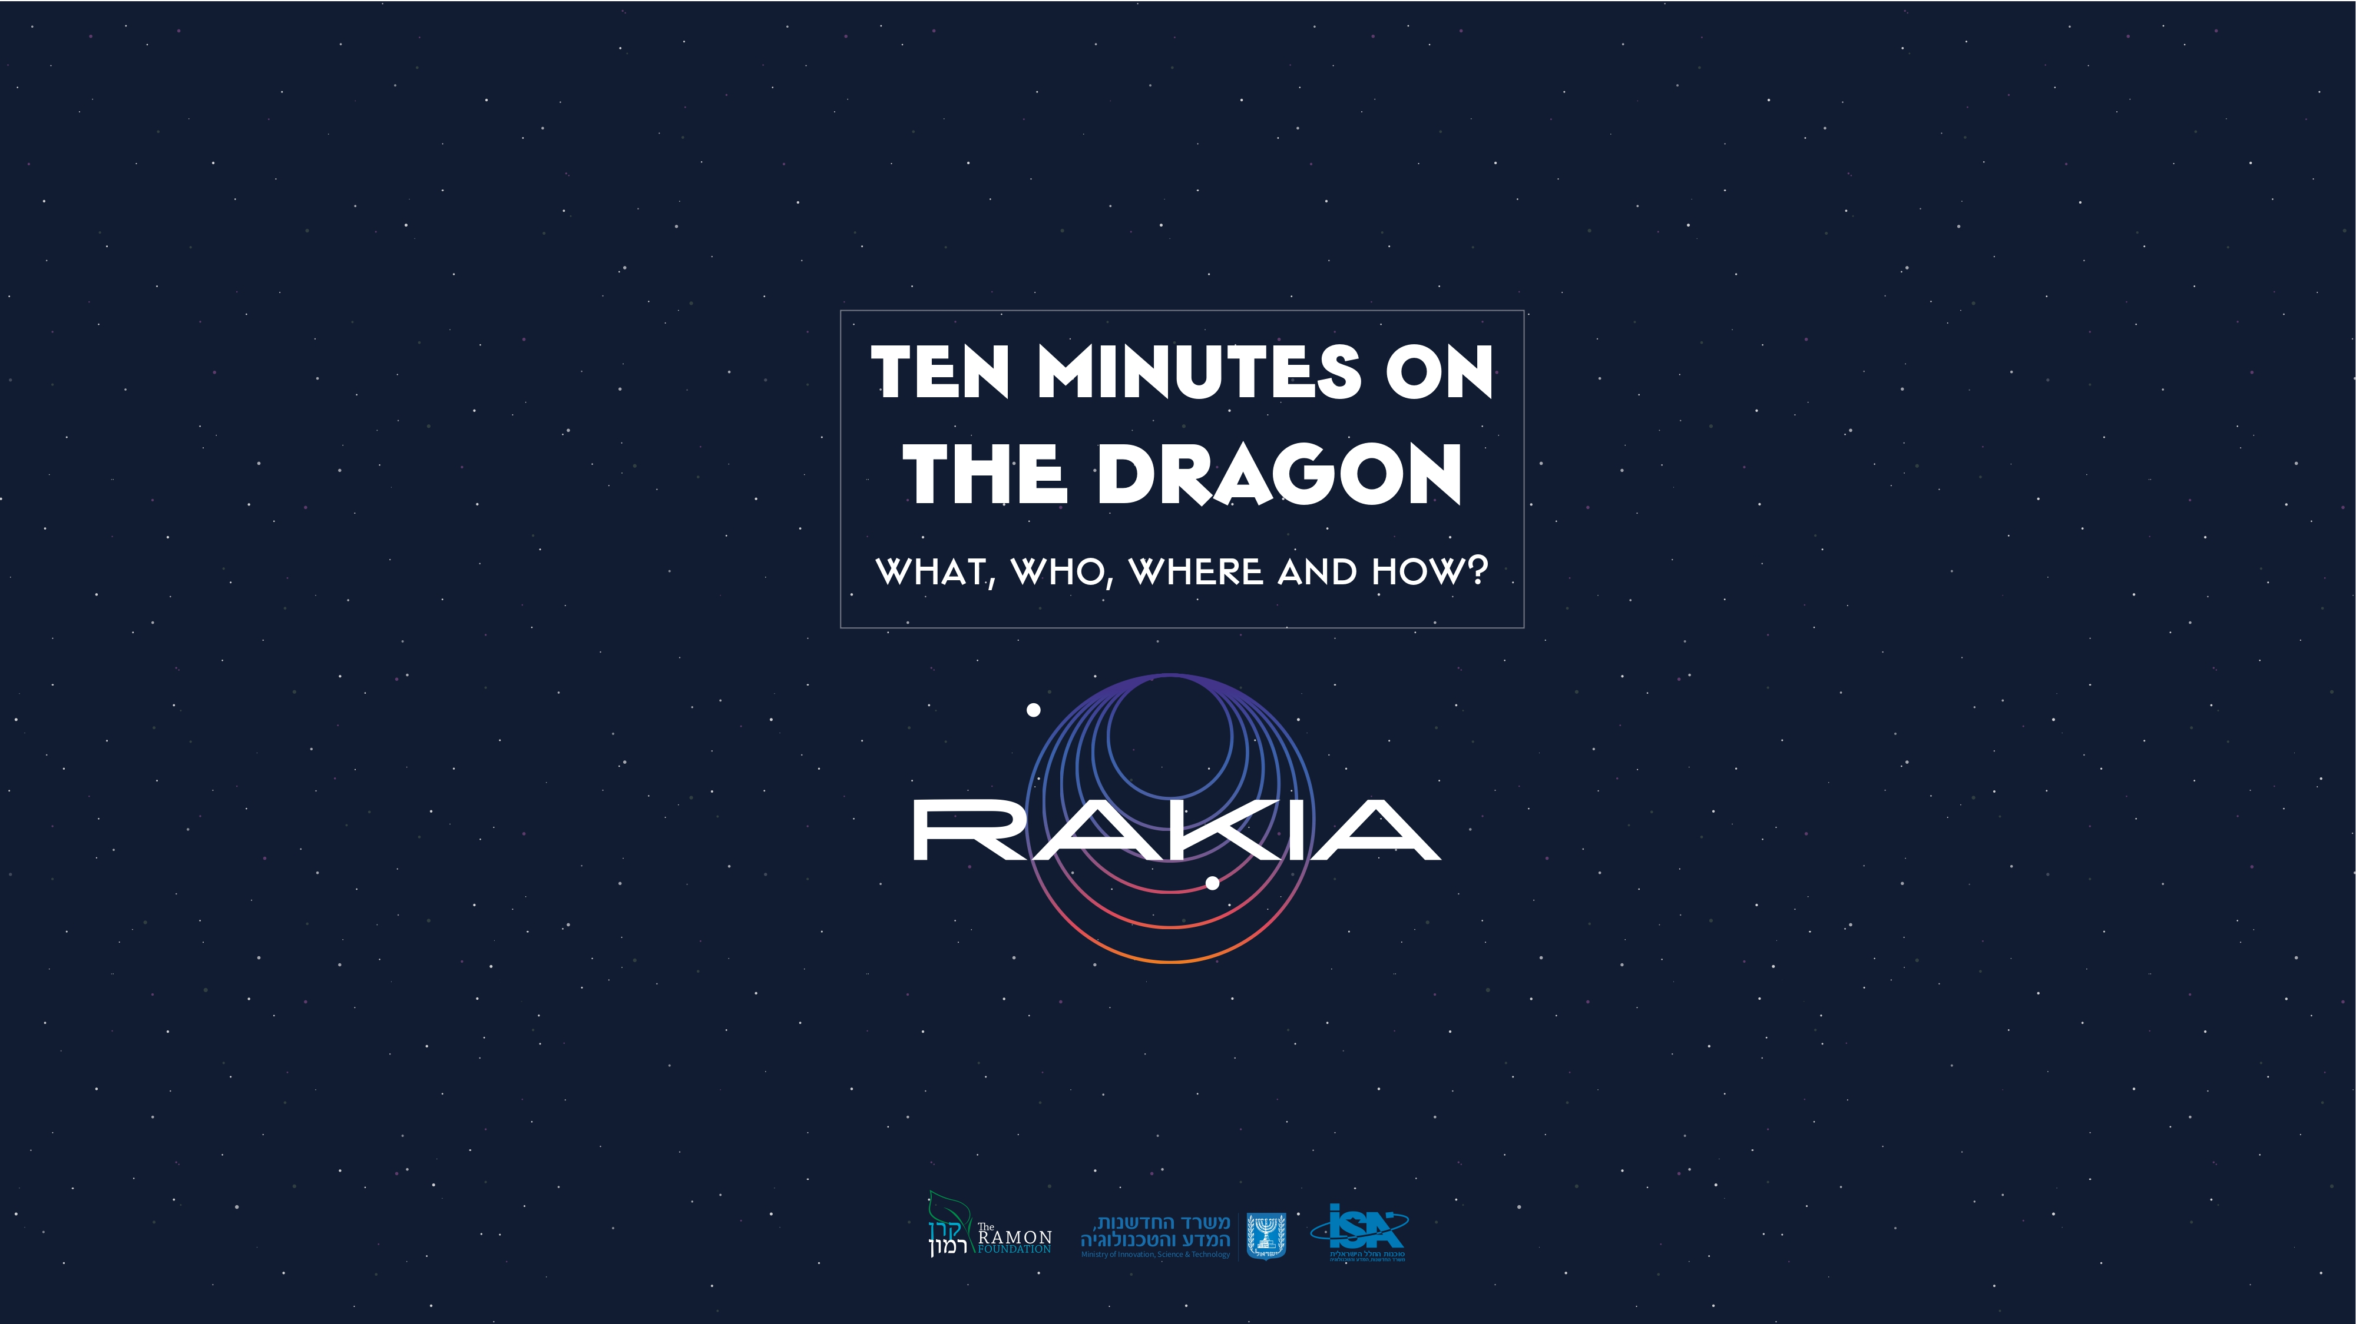

Slide 2


Slide 3
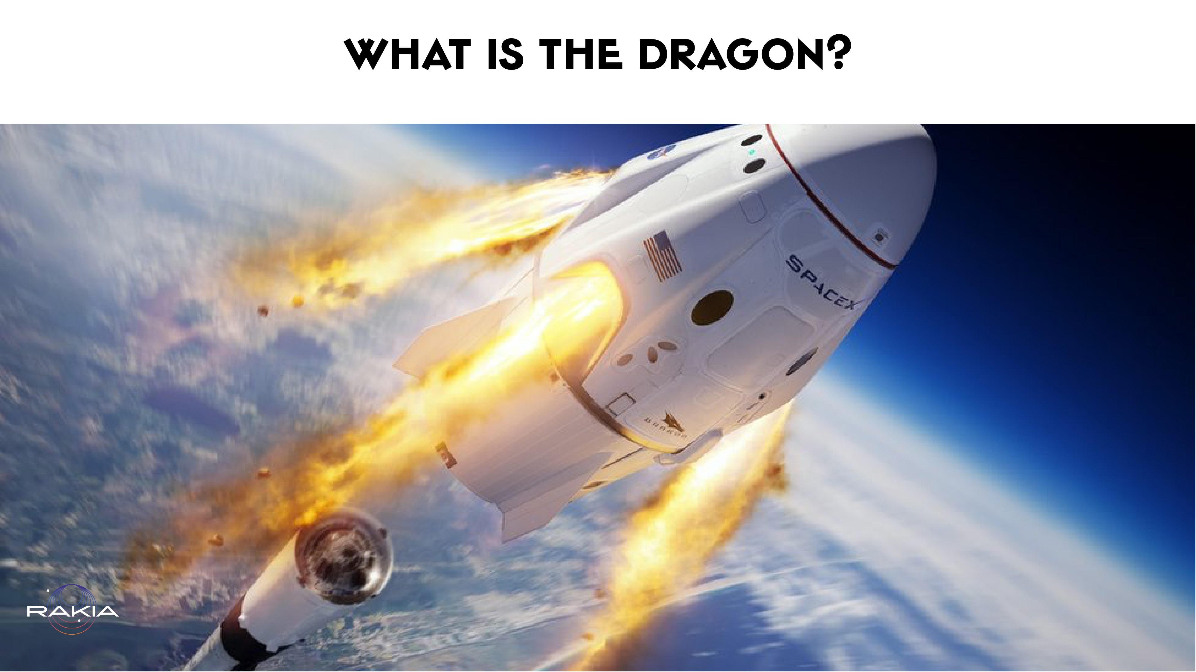
Notes:
It is a model of spacecraft built by SpaceX This spacecraft comes in two configurations - one for carrying people and one for carrying cargo only.
CREW DRAGON - is the manned version. It measures a mere 8 by 4 meters. This is the spacecraft that will be transporting Eytan Stibbe, the second Israeli in space, beyond Earth’s gravity. The specific Dragon spacecraft designated to the AX-1 mission is named RESILIENCE

Slide 4


Slide 5
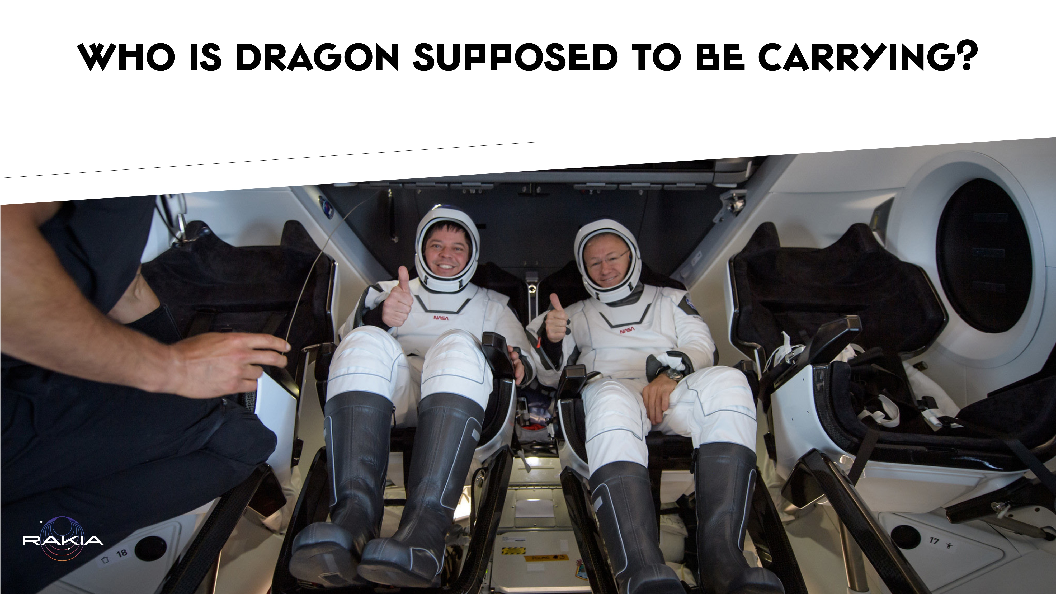
Notes:
Women, men and equipment to the Space Station and from the Space Station back to Earth.
It seats seven and contains storage spaces and bathrooms.
This spacecraft did its maiden voyage on date. This voyage was unmanned, for safety sake. It carried a soft Earth-shaped doll, which was nicknamed Earthy.

Slide 6


Slide 7
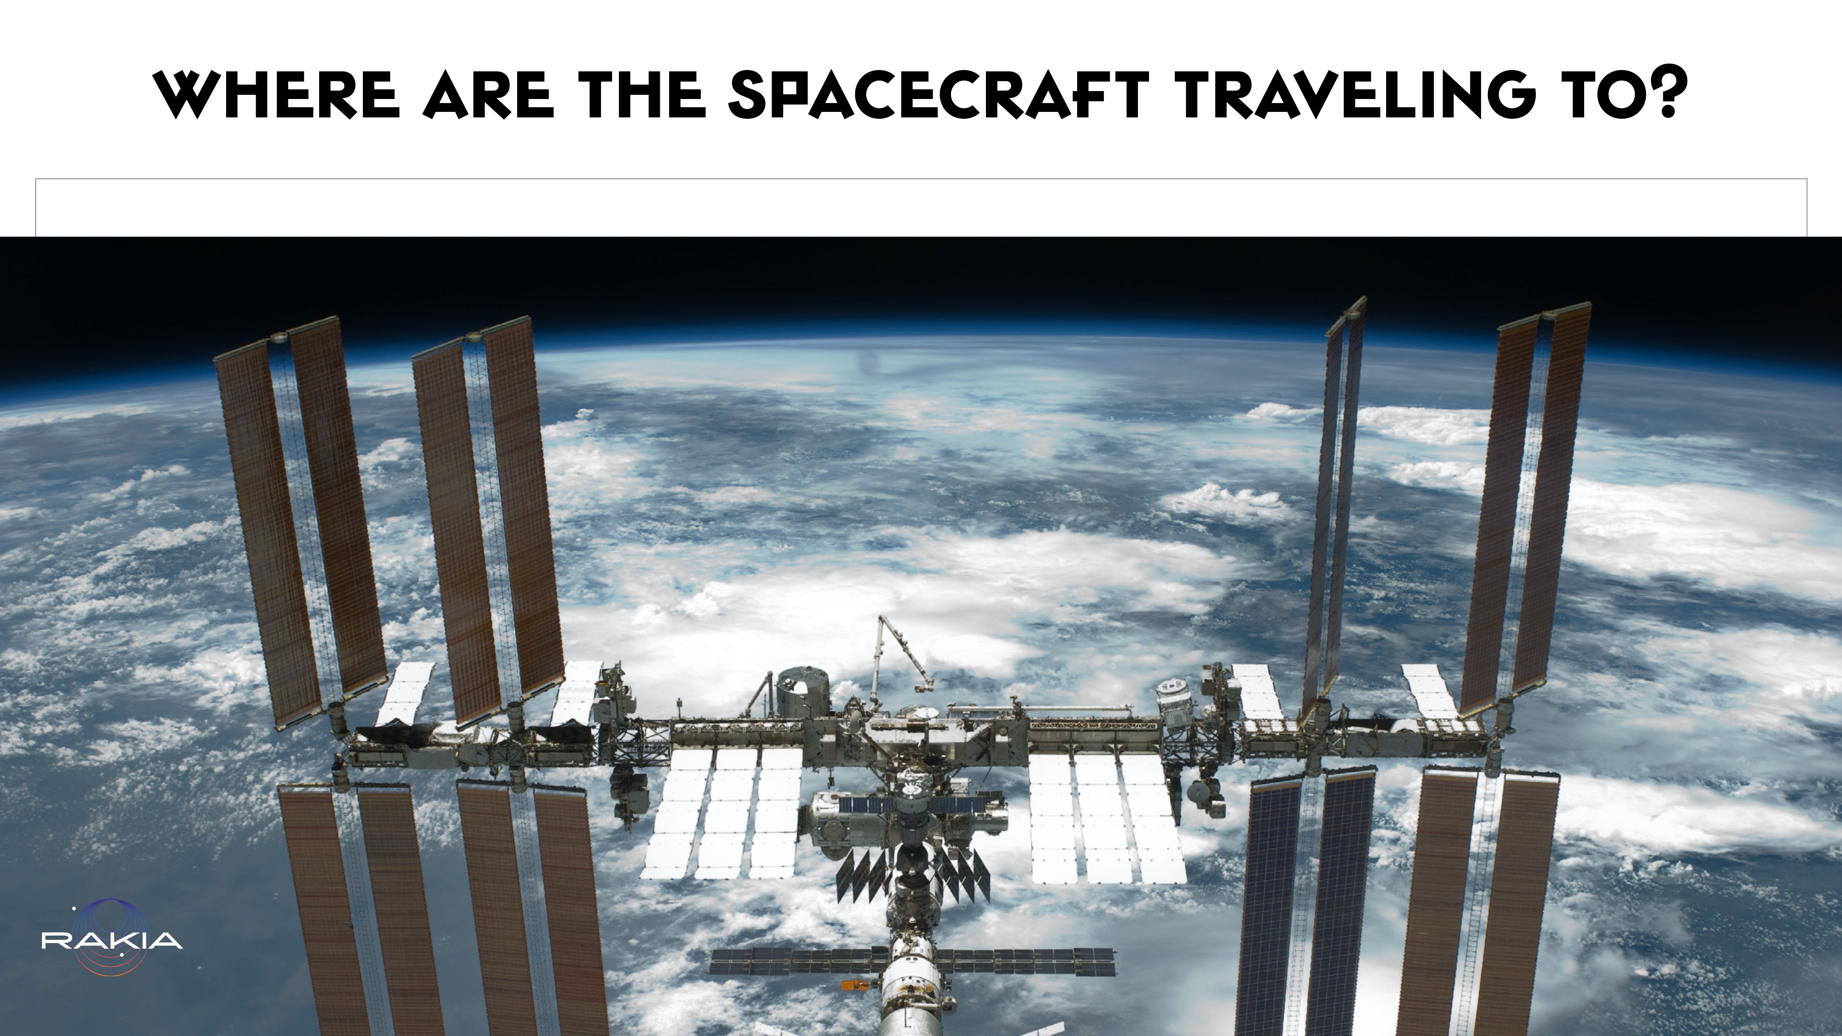
Notes:
The spacecraft are intended for re-use, traveling between Earth (or someday perhaps a different planet!) and into orbit around Earth.
Currently, Dragon carries people and cargo to the International Space Station, and back.

Slide 8


Slide 9
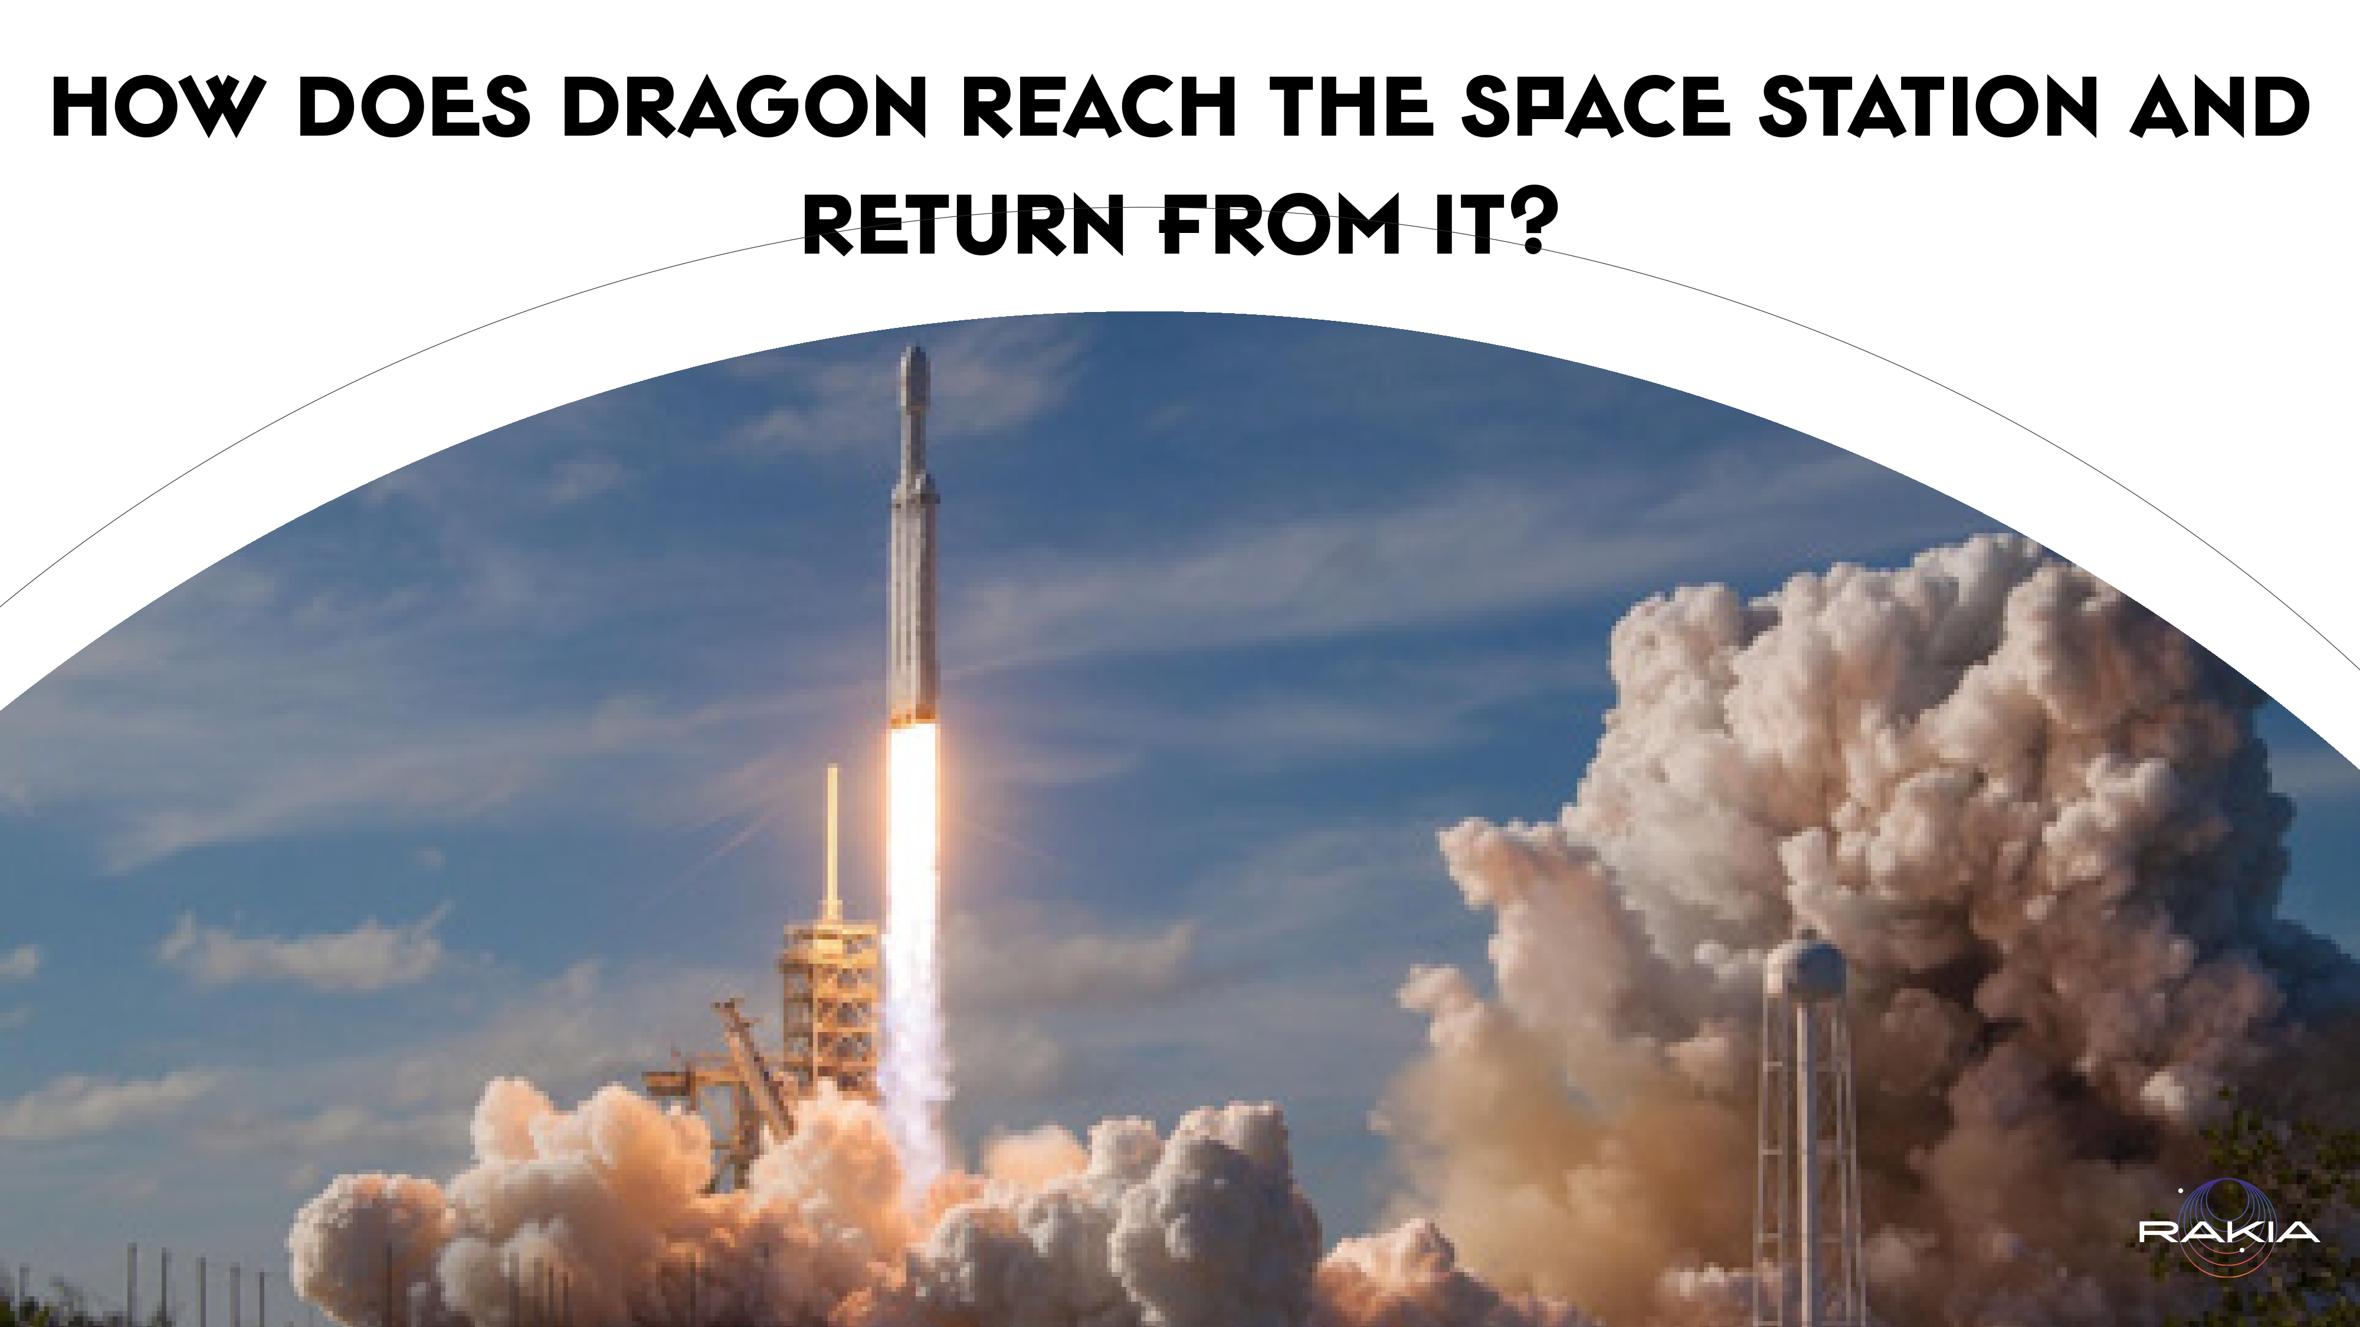
Notes:
The spacecraft is launched into orbit on a launch vehicle, named Falcon 9. The launch vehicle is a powerful rocket - a huge fuel tank with engines and a computer. It carries the spacecraft beyond the atmosphere and when it reaches the right location the rocket disconnects from the spacecraft. The spacecraft then activates its own engines to propel it toward the space station arriving precisely at the right location, time, speed and orientation

Slide 10
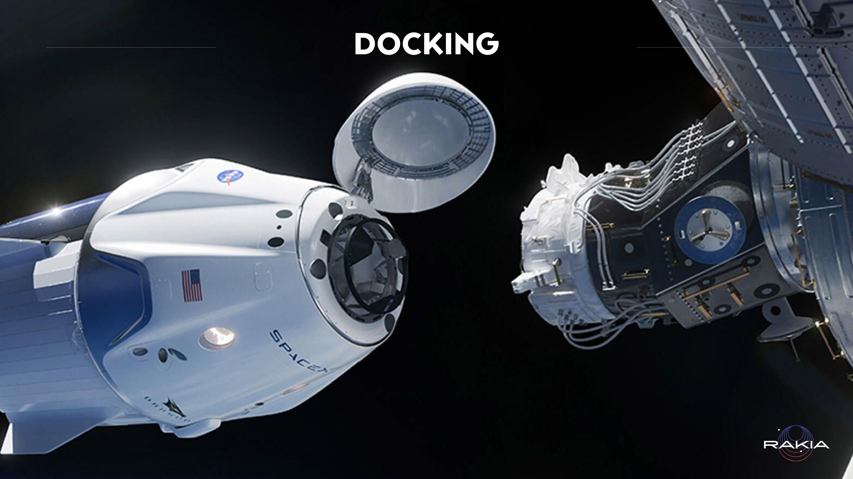
Notes:
The spacecraft docks with the Station and creates a tight connection between the two, enabling people and equipment to safely pass from one to the other. When the spacecraft’s stay at the Station ends, the hatches close, the spacecraft disengages from the Station, and activates its engines to begin its controlled descent back towards Earth.
Link to a docking game with the Station and practicing controlling the spacecraft /https://iss-sim.spacex.com

Slide 11
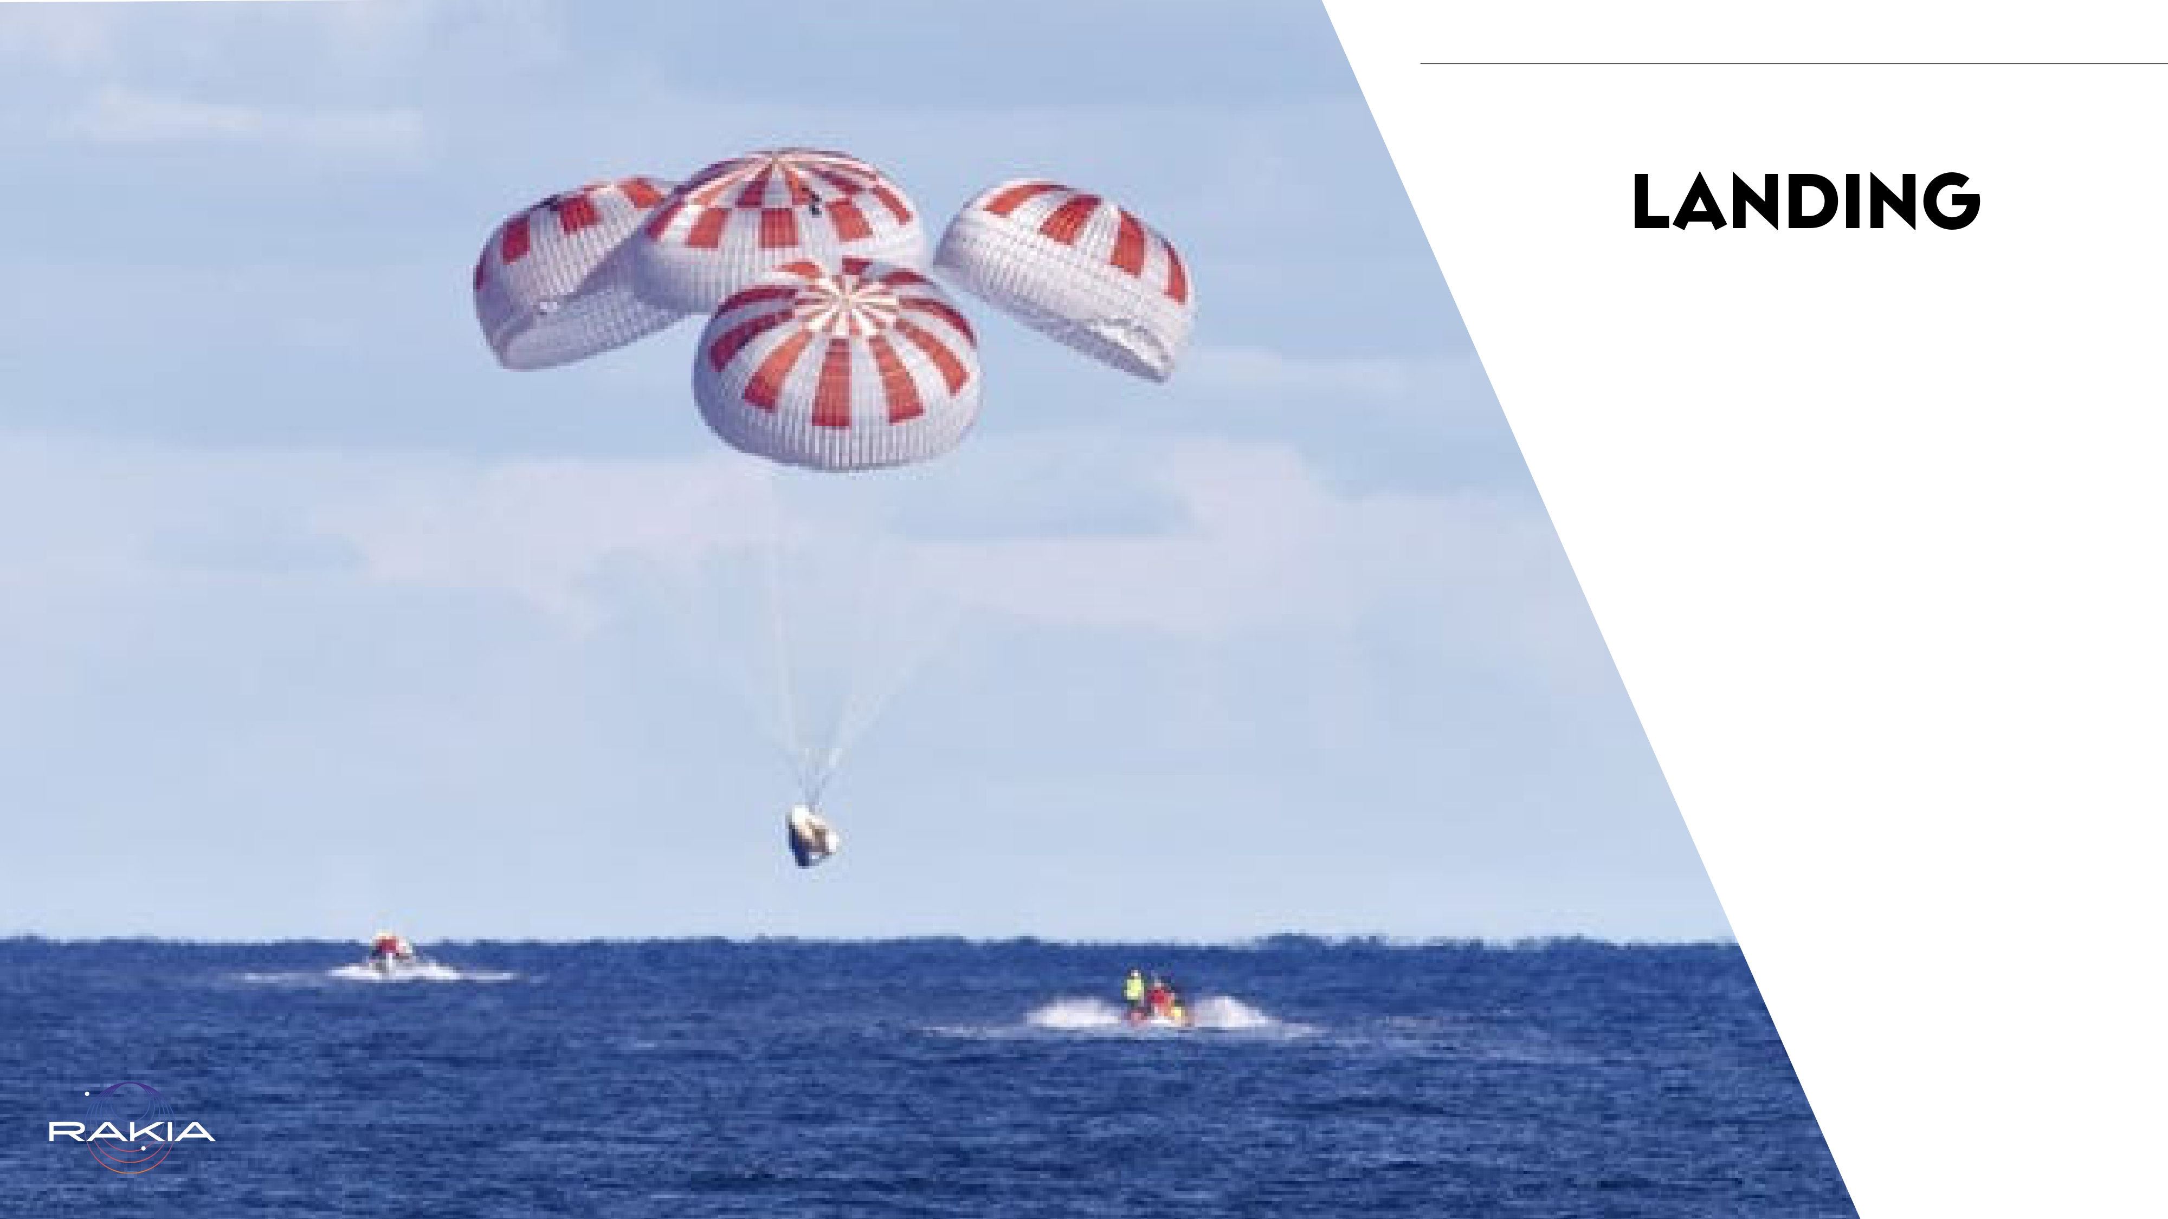
Notes:
The spacecraft is protected and has four parachutes. It orients itself with its broad side facing toward Earth to achieve maximum deceleration while re-entering the atmosphere on its way back. At the appropriate altitude the parachutes are deployed to further reduce the spacecraft’s touchdown velocity. Eventually it splashes down in the ocean. Boats, which await the spacecraft’s return, make their way to it as quickly as possible and pull the spacecraft, its parachutes, and the astronauts out of the water and return them to shore

Slide 12
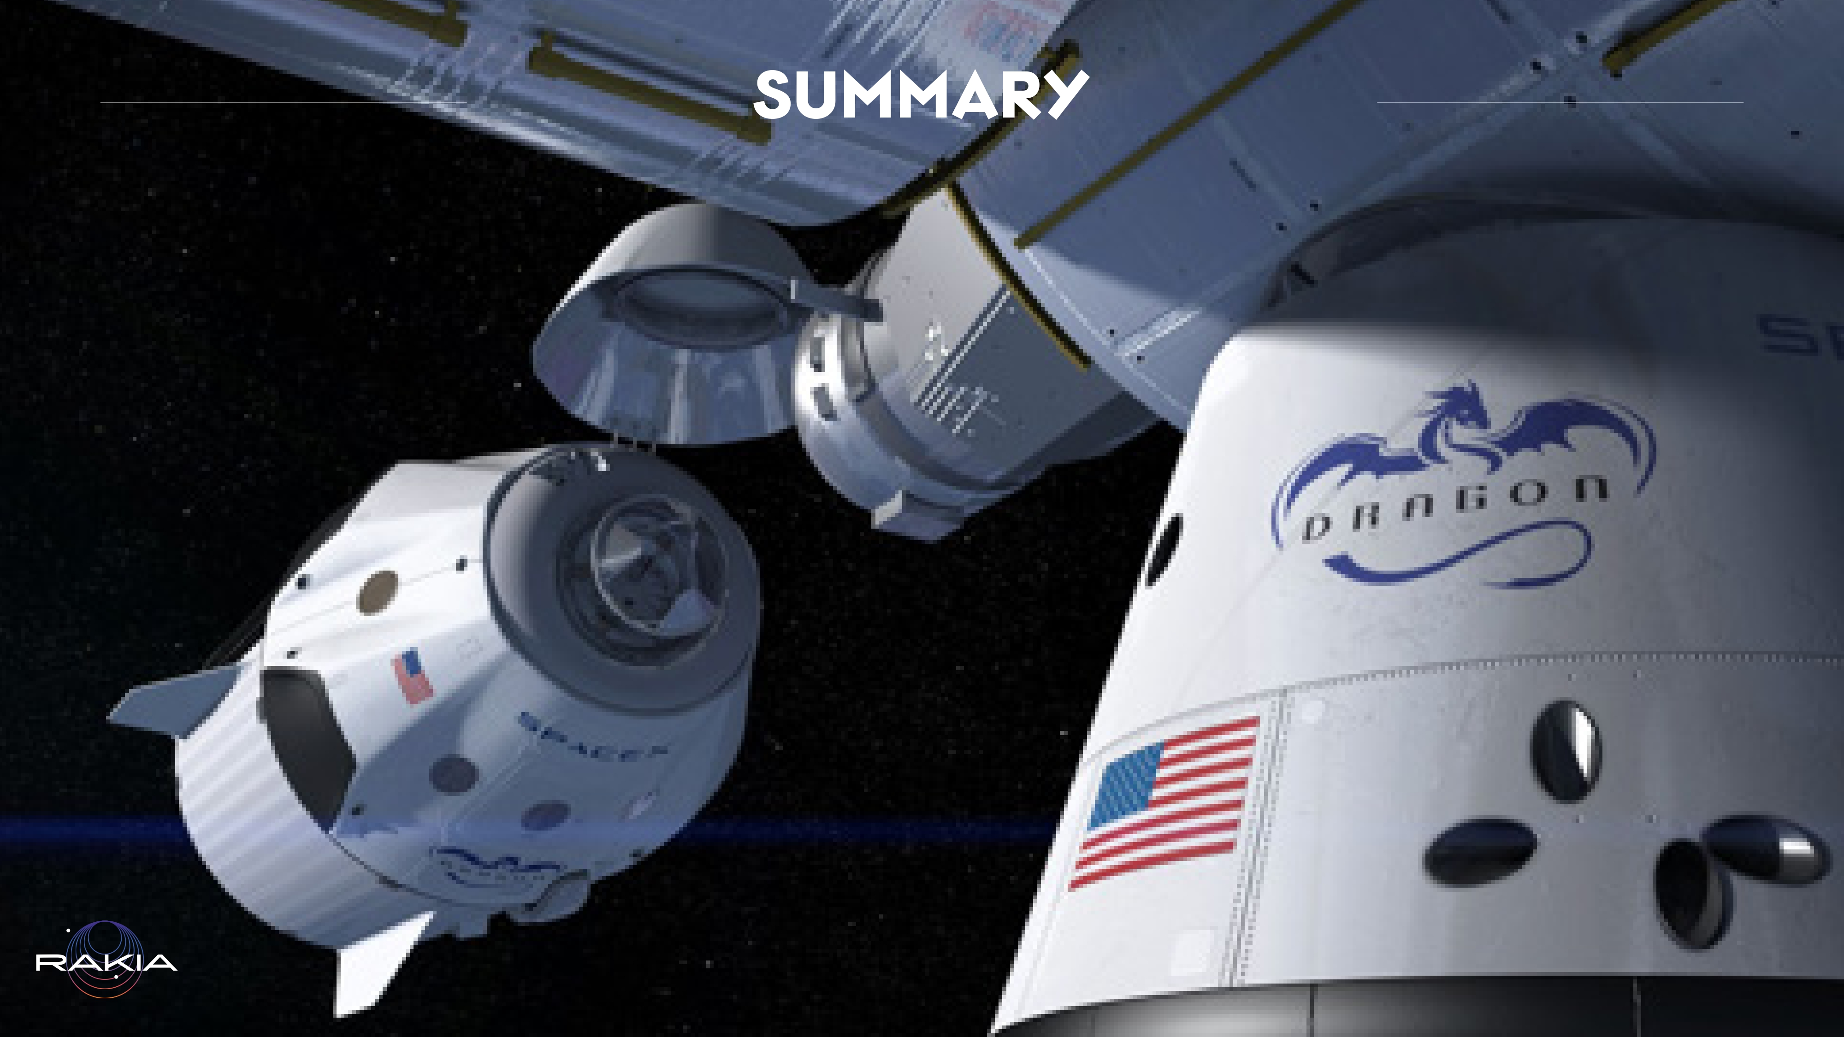
Notes:
In this website you can track the number of launches, number of visits to the Space Station, and the number of times the Dragon spacecraft has been re-used
SpaceX – Dragon

Slide 13

Notes:
Correctly answer this string of questions in ascending order of difficulty. Every mistake sends you back to the start point. You can play the game again and again. Important: All the answers are included in the presentation. Even if you don’t know the answer, you’ll be able to find it by doing a quick search and then come back and answer, or you can make a mistake and then note what the correct answer is, remember it, and restart the game
Got to the million? Try again, but time yourself this time
https://learningapps.org/16800084

